Slide 1
Assessing DFT+U methods and associated corrections to describe lanthanide-doped, large band gap oxides
Dan Criveanu

Slide 2
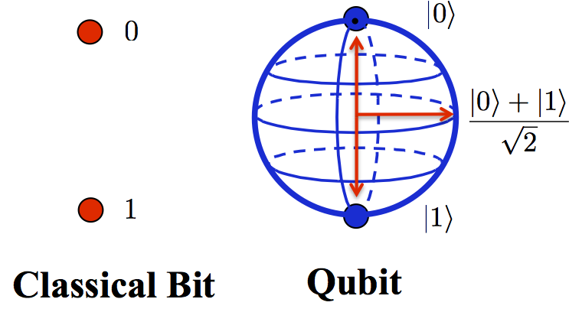
Quantum computers can make many currently infeasible problems feasible

Slide 3
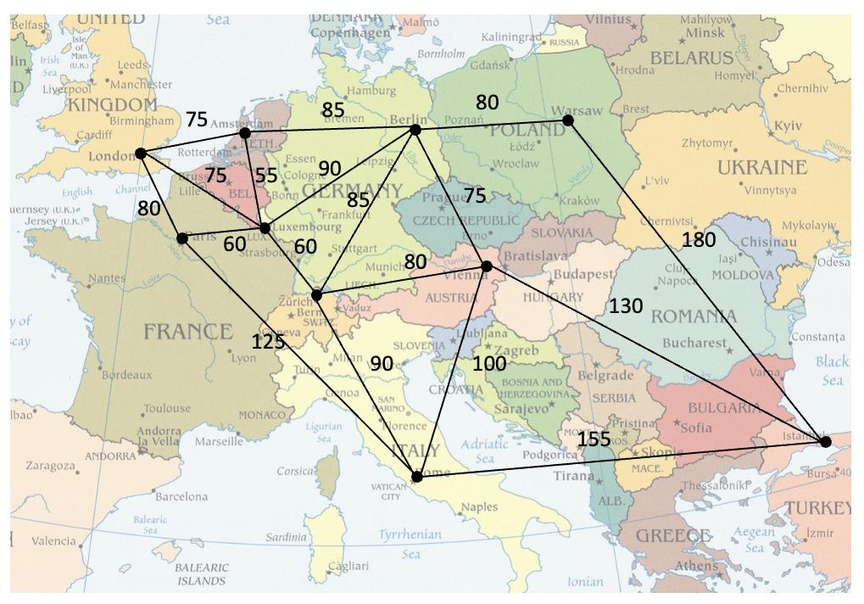
Quantum computers can make many currently infeasible problems feasible

Slide 4
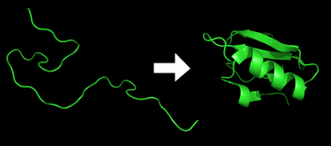
Quantum computers can make many currently infeasible problems feasible

Slide 5
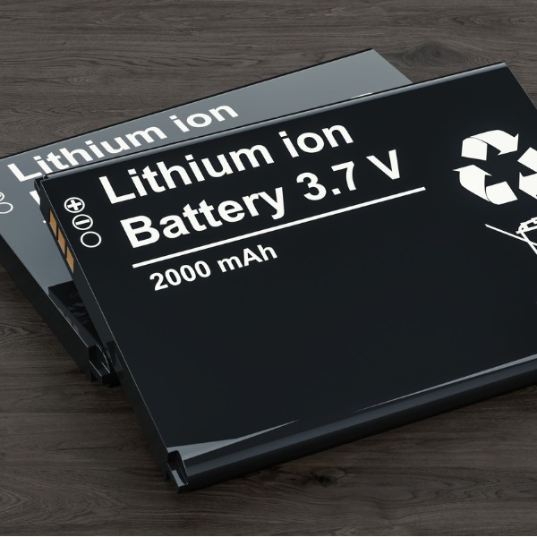
Quantum computers can make many currently infeasible problems feasible

Slide 6

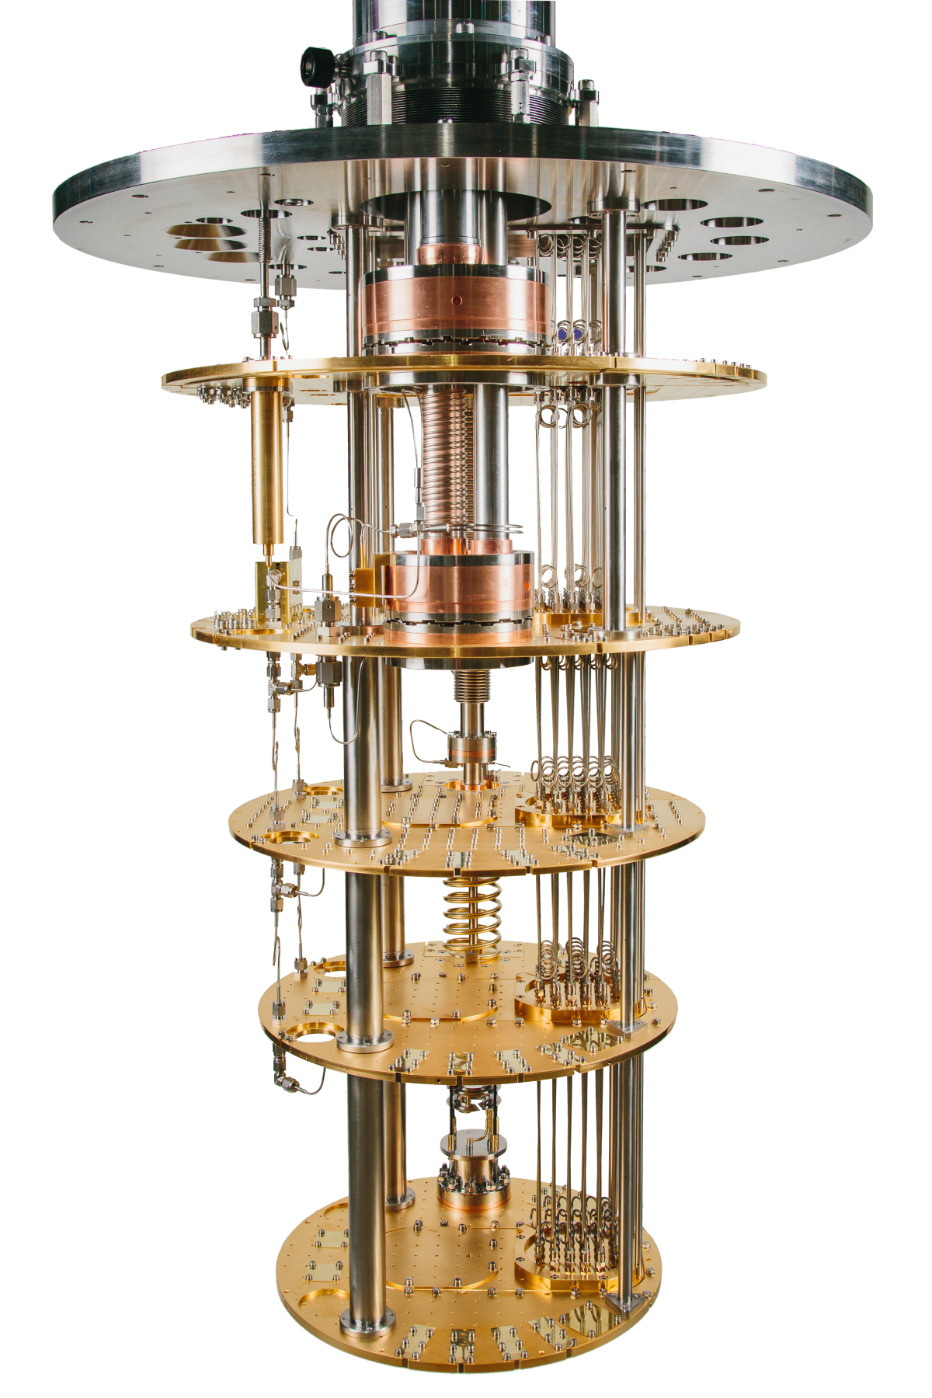
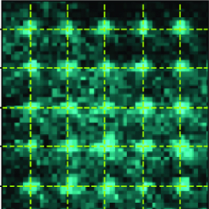
New materials need to be discovered for quantum computing
Quantum computers currently have problems with:
Stability
Scalability
Qubits are kept at 15 millikelvin in a dilution refrigerator.
Current qubit limit is 54. We need thousands.
Notes:
Stability – IBM’s quantum computers need to be kept at very low temperatures (15 millikelvin in a dilution refrigerator).
Scalability – currently having too many qubits will lead to the qubits deactivating each other.

Slide 7
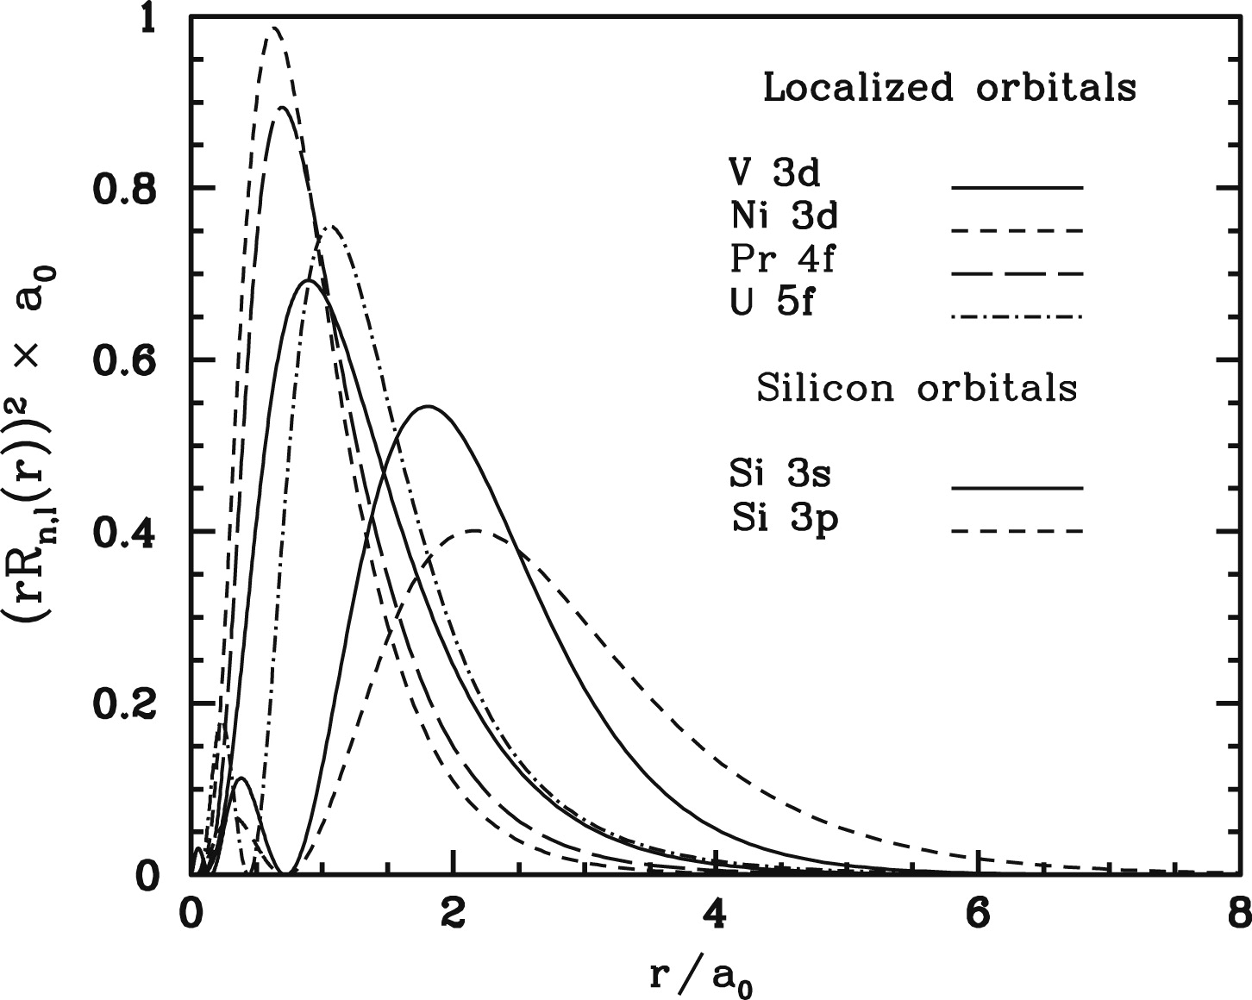
Potential solution: Lanthanide dopants in wide band gap oxides
f- (and d-) orbitals are highly localised
d/f
s/p

Slide 8
Potential solution: Lanthanide dopants in wide band gap oxides
f- (and d-) orbitals are highly localised
Ln dopant in a wide band gap host
d/f
Conduction band
s/p
Ln 5d (empty)
E
Ln 4f (filled)
Valence band

Slide 9
Potential solution: Lanthanide dopants in wide band gap oxides
f- (and d-) orbitals are highly localised
Ln dopant in a wide band gap host
d/f
Conduction band
s/p
Ln 5d (empty)
E
Ln 4f (filled)
Valence band
Problem: DFT does not accurately describe f- (and d-) states

Slide 10
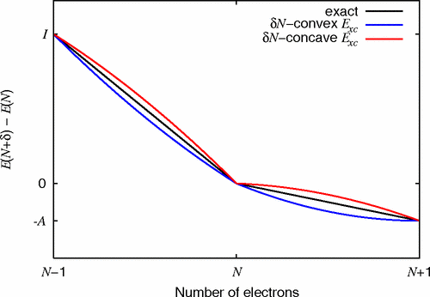
DFT suffers from the derivative discontinuity

Slide 11
DFT suffers from the derivative discontinuity
Problems:
The exact exchange-correlation functional is not known.

Slide 12
DFT suffers from the derivative discontinuity
Problems:
The exact exchange-correlation functional is not known.
Approximate functionals display continuous, concave behaviour.

Slide 13
DFT suffers from the derivative discontinuity
Problems:
The exact exchange-correlation functional is not known.
Approximate functionals display continuous, concave behaviour.
The lack of derivative discontinuity partly leads to the “band gap problem”.

Slide 14
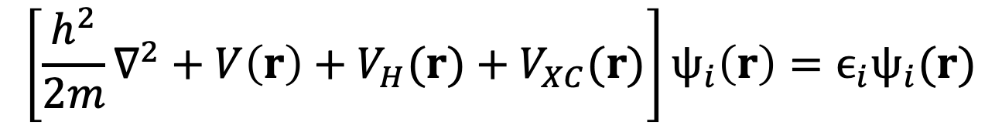
DFT suffers from the self-interaction error
$$\left[\frac{h^{2}}{2m}{\text{∇}}^{2}+V\left(r\right)+V_{H}(r)+V_{XC}(r)\right]ψ_{i}\left(r\right)=ϵ_{i}ψ_{i}(r)$$
Notes:
In the KS formulation, energy is calculated by solving a series of one-electron equations of the form (seen above).
Kohn-Sham equations are single-electron wave functions that depend on only three spatial variables, psi_i(r).

Slide 15
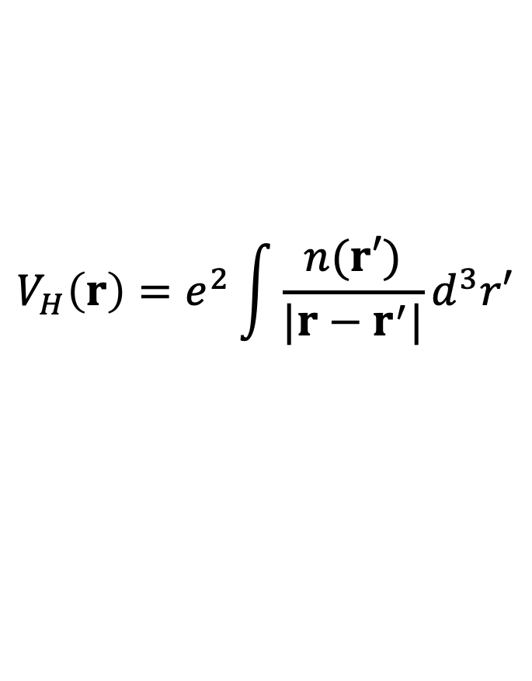
DFT suffers from the self-interaction error
$$\left[\frac{h^{2}}{2m}{\text{∇}}^{2}+V\left(r\right)+V_{H}(r)+V_{XC}(r)\right]ψ_{i}\left(r\right)=ϵ_{i}ψ_{i}(r)$$
$$V_{H}\left(r\right)=e^{2}\int{\frac{n(r′)}{|r−r^{′}|}d^{3}r′}$$
The Hartree potential introduces the self-interaction error.
Notes:
The Hartree potential describes the Coulomb repulsion between the electron and the system’s total electron density.

Slide 16
DFT suffers from the self-interaction error
$$\left[\frac{h^{2}}{2m}{\text{∇}}^{2}+V\left(r\right)+V_{H}(r)+V_{XC}(r)\right]ψ_{i}\left(r\right)=ϵ_{i}ψ_{i}(r)$$
$$V_{H}\left(r\right)=e^{2}\int{\frac{n(r′)}{|r−r^{′}|}d^{3}r′}$$
The exact exchange-correlation potential contains the self-interaction correction.
The Hartree potential introduces the self-interaction error.
Notes:
The Hartree potential describes the Coulomb repulsion between the electron and the system’s total electron density.

Slide 17
DFT suffers from the self-interaction error
$$\left[\frac{h^{2}}{2m}{\text{∇}}^{2}+V\left(r\right)+V_{H}(r)+V_{XC}(r)\right]ψ_{i}\left(r\right)=ϵ_{i}ψ_{i}(r)$$
$$V_{H}\left(r\right)=e^{2}\int{\frac{n(r′)}{|r−r^{′}|}d^{3}r′}$$
The exact exchange-correlation potential contains the self-interaction correction.
The Hartree potential introduces the self-interaction error.
Problem: the exact exchange-correlation functional is not known → the self-interaction error remains.
DFT over-delocalises electron density.
Notes:
The Hartree potential describes the Coulomb repulsion between the electron and the system’s total electron density.

Slide 18

DFT suffers from the self-interaction error
e⁻
e⁻

Slide 19
DFT+U – a short summary
DFT+U (simplest) formulation
$$E^{DFT+U}\left[n\left(r\right)\right]= E^{DFT}\left[n\left(r\right)\right]+ E^{Hub}\left[\left\{n_{m_{l}}^{Iσ}\right\}\right]− E^{DC}[N^{Iσ}]$$
Notes:
This expression has been written for the simplest and most common case of a single subshell nl on site I with associated magnetic quantum numbers, ml, upon which a Hubbard term is applied and a double-counting term that depends on total occupation of that subshell, N Iσ.
EHub is the term that contains the Hubbard Hamiltonian to model correlated states.
Because of the additive nature of this correction, it is necessary to eliminate from the (approximate) DFT functional, ELDA, the part of the interaction energy to be modeled by EHub. This task is accomplished through the subtraction of the so-called “double-counting” (dc) term Edc that models the contribution of correlated electrons to the DFT energy as a mean-field approximation of EHub.
In its general form, DFT+U may be thought of as the net contribution from (1) the standard DFT calculation (EDFT), (2) the Hubbard term (EHub) that explicitly models the Coulomb energy associated with the localized atomic orbitals of interest (e.g., 3d electrons), and (3) removal of a double counting term (EDC) that corresponds to a mean field description of these interactions obtained in the homogeneous electron gas limit with a standard DFT functional.

Slide 20
DFT+U – a short summary
DFT+U (simplest) formulation
$$E^{DFT+U}\left[n\left(r\right)\right]= E^{DFT}\left[n\left(r\right)\right]+ E^{Hub}\left[\left\{n_{m_{l}}^{Iσ}\right\}\right]− E^{DC}[N^{Iσ}]$$
U – Coulomb parameter
J – exchange parameter
U acts to increase localization, decrease the energy of filled states and increase the energy of unfilled states. J does the opposite.
Notes:
This expression has been written for the simplest and most common case of a single subshell nl on site I with associated magnetic quantum numbers, ml, upon which a Hubbard term is applied and a double-counting term that depends on total occupation of that subshell, N Iσ.
EHub is the term that contains the Hubbard Hamiltonian to model correlated states.
Because of the additive nature of this correction, it is necessary to eliminate from the (approximate) DFT functional, ELDA, the part of the interaction energy to be modeled by EHub. This task is accomplished through the subtraction of the so-called “double-counting” (dc) term Edc that models the contribution of correlated electrons to the DFT energy as a mean-field approximation of EHub.
In its general form, DFT+U may be thought of as the net contribution from (1) the standard DFT calculation (EDFT), (2) the Hubbard term (EHub) that explicitly models the Coulomb energy associated with the localized atomic orbitals of interest (e.g., 3d electrons), and (3) removal of a double counting term (EDC) that corresponds to a mean field description of these interactions obtained in the homogeneous electron gas limit with a standard DFT functional.

Slide 21
DFT+U – a short summary
DFT+U (simplest) formulation
$$E^{DFT+U}\left[n\left(r\right)\right]= E^{DFT}\left[n\left(r\right)\right]+ E^{Hub}\left[\left\{n_{m_{l}}^{Iσ}\right\}\right]− E^{DC}[N^{Iσ}]$$
U – Coulomb parameter
J – exchange parameter
U acts to increase localization, decrease the energy of filled states and increase the energy of unfilled states. J does the opposite.
Popular simplifying assumption (Dudarev): U_{eff} = U - J
Notes:
This expression has been written for the simplest and most common case of a single subshell nl on site I with associated magnetic quantum numbers, ml, upon which a Hubbard term is applied and a double-counting term that depends on total occupation of that subshell, N Iσ.
EHub is the term that contains the Hubbard Hamiltonian to model correlated states.
Because of the additive nature of this correction, it is necessary to eliminate from the (approximate) DFT functional, ELDA, the part of the interaction energy to be modeled by EHub. This task is accomplished through the subtraction of the so-called “double-counting” (dc) term Edc that models the contribution of correlated electrons to the DFT energy as a mean-field approximation of EHub.
In its general form, DFT+U may be thought of as the net contribution from (1) the standard DFT calculation (EDFT), (2) the Hubbard term (EHub) that explicitly models the Coulomb energy associated with the localized atomic orbitals of interest (e.g., 3d electrons), and (3) removal of a double counting term (EDC) that corresponds to a mean field description of these interactions obtained in the homogeneous electron gas limit with a standard DFT functional.

Slide 22
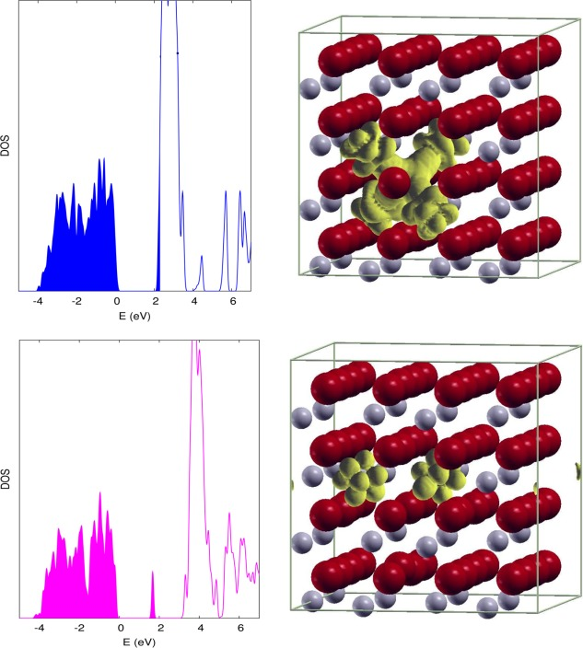
DFT+U addresses the self-interaction error
Regular DFT
CeO₂ with an oxygen vacancy
DOS
E
DFT+U
U enforces localisation of the electron density
DOS
E
B. Himmetoglu et al., International Journal of Quantum Chemistry, 2013, 114, 14–49.

Slide 23
DFT+U addresses the derivative discontinuity

Slide 24
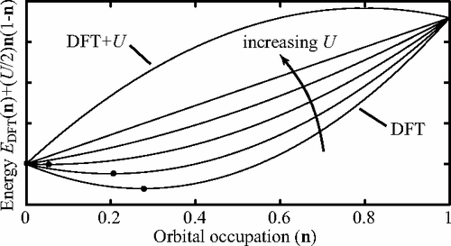
DFT+U addresses the derivative discontinuity
DFT+U addresses these problems

Slide 25
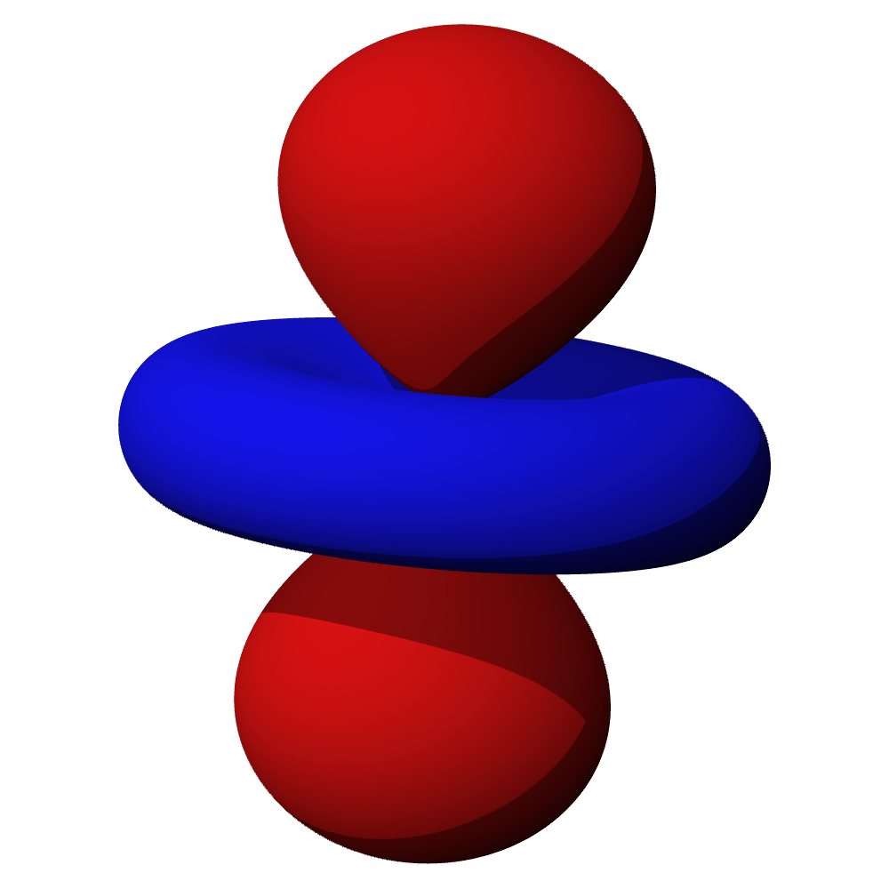
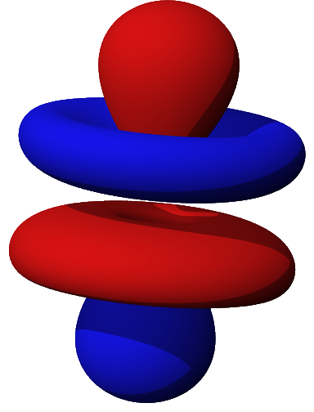
DFT+U is traditionally applied to d-orbitals
dz²
fz³
Not as much work has been done on f-orbitals as has been done on d-orbitals, especially in the context of lanthanide dopants.

Slide 26
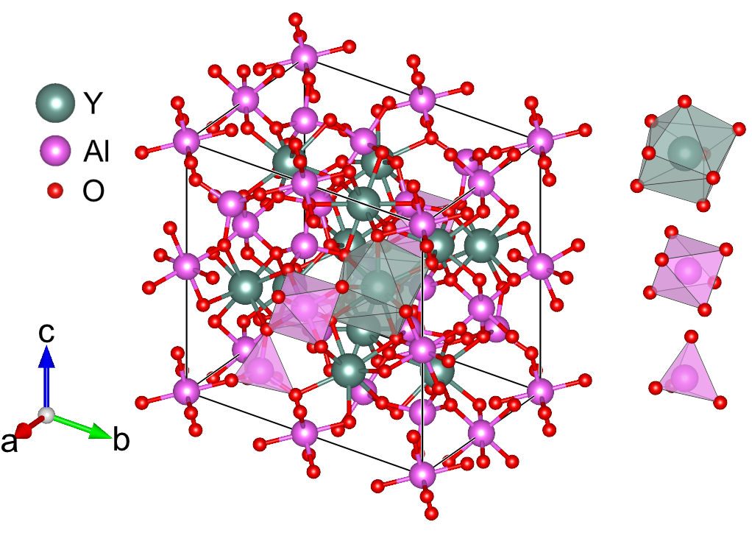

Test system – Cerium-doped yttrium aluminium garnet – YAG primitive cell
Yttrium aluminium garnet/YAG (Y₃Al₅O₁₂)
Cubic: $Ia\overline{3}d$
Y_{dodec}
Al_{oct}
Al_{tet}

Slide 27

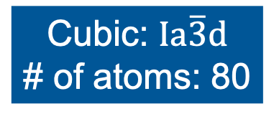
Test system – Cerium-doped yttrium aluminium garnet – creating a cubic supercell
Yttrium aluminium garnet/YAG (Y₃Al₅O₁₂)
Conditions:
Minimum length: 10 Å
Max # of atoms: 300
Cubic: $Ia\overline{3}d$
# of atoms: 80

Slide 28
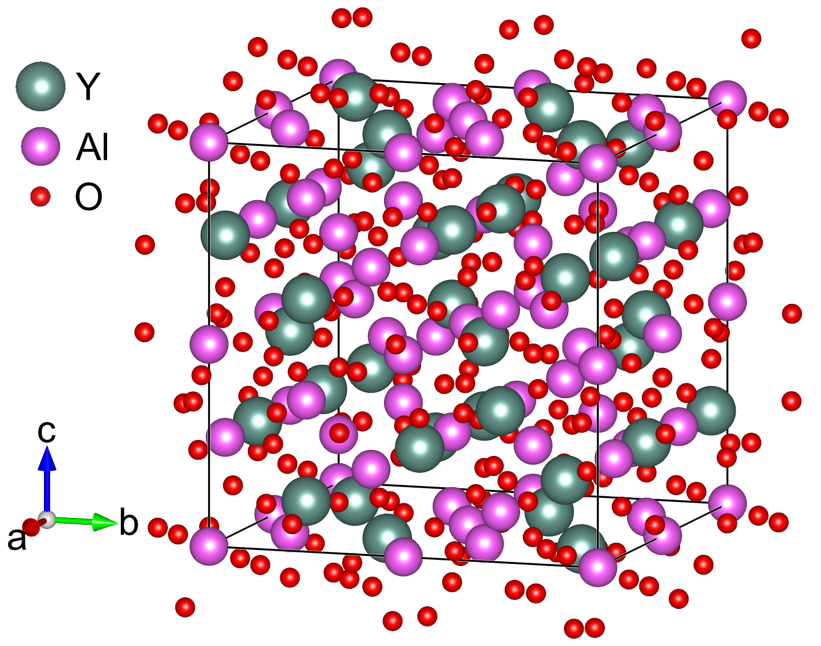
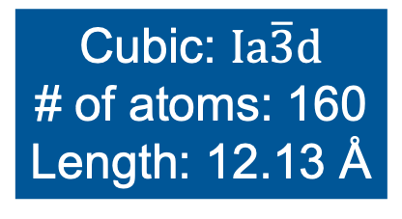
Test system – Cerium-doped yttrium aluminium garnet – creating a cubic supercell
Yttrium aluminium garnet/YAG (Y₃Al₅O₁₂)
Conditions:
Minimum length: 10 Å
Max # of atoms: 300
Cubic: $Ia\overline{3}d$
# of atoms: 160
Length: 12.13 Å
Cubic: $Ia\overline{3}d$
# of atoms: 80

Slide 29
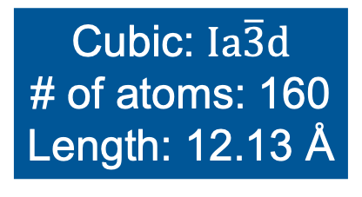
Test system – Cerium-doped yttrium aluminium garnet – doping the cubic supercell
Yttrium aluminium garnet/YAG (Y₃Al₅O₁₂)
Cubic: $Ia\overline{3}d$
# of atoms: 160
Length: 12.13 Å

Slide 30

Test system – Cerium-doped yttrium aluminium garnet – doping the cubic supercell
Yttrium aluminium garnet/YAG (Y₃Al₅O₁₂)
Doping here
Cubic: $Ia\overline{3}d$
# of atoms: 160
Length: 12.13 Å

Slide 31
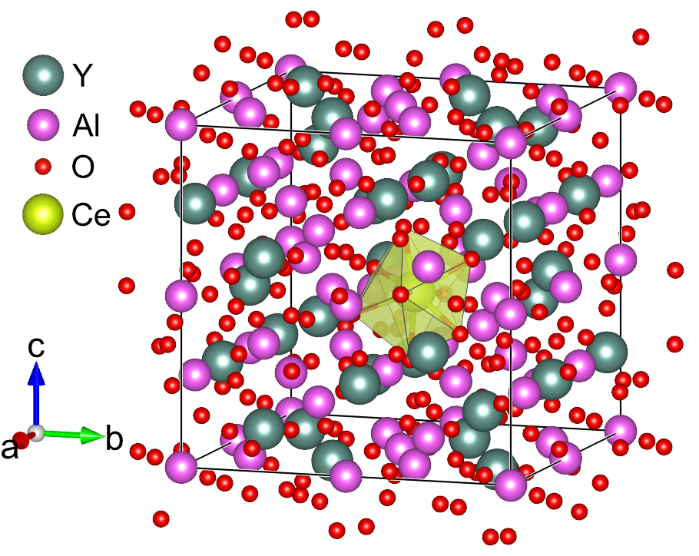
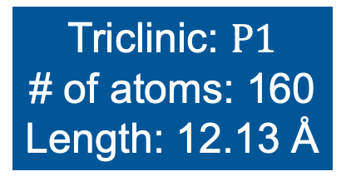
Test system – Cerium-doped yttrium aluminium garnet – doping the cubic supercell
Yttrium aluminium garnet/YAG (Y₃Al₅O₁₂)
Doping here
YAG:Ce
Cubic: $Ia\overline{3}d$
# of atoms: 160
Length: 12.13 Å
Triclinic: $P1$
# of atoms: 160
Length: 12.13 Å

Slide 32
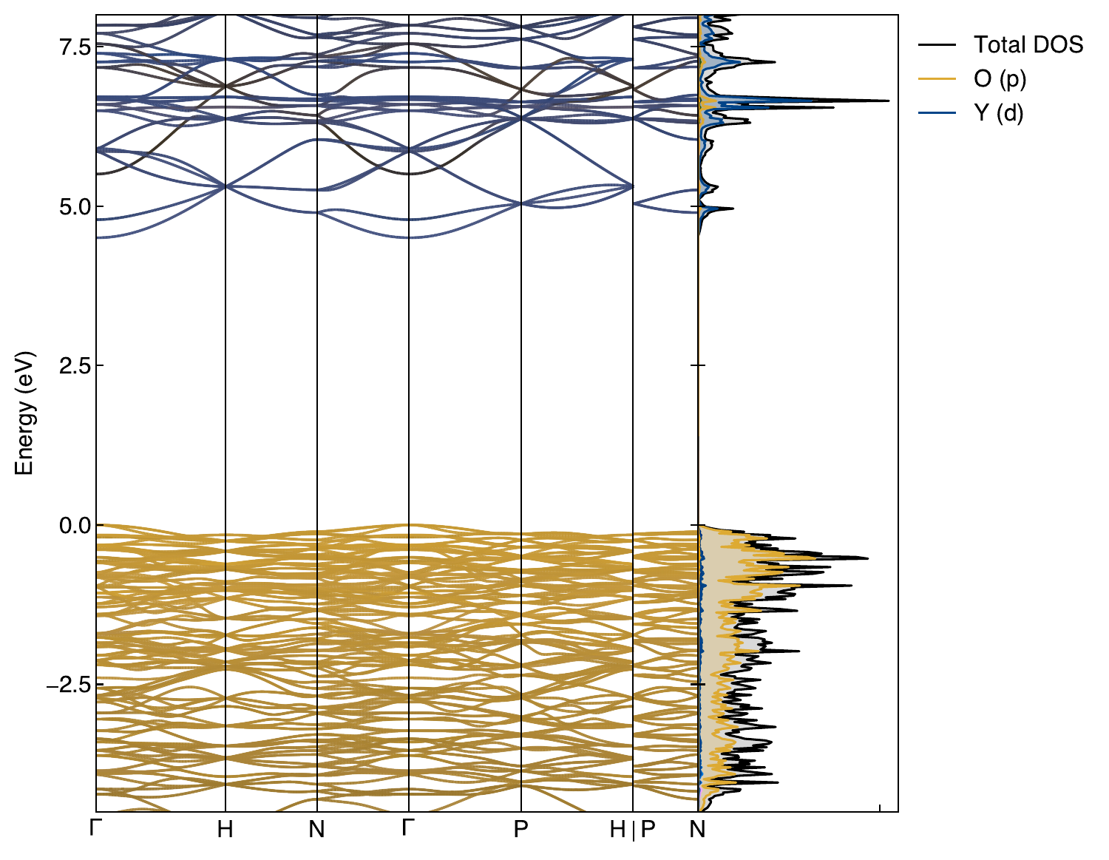
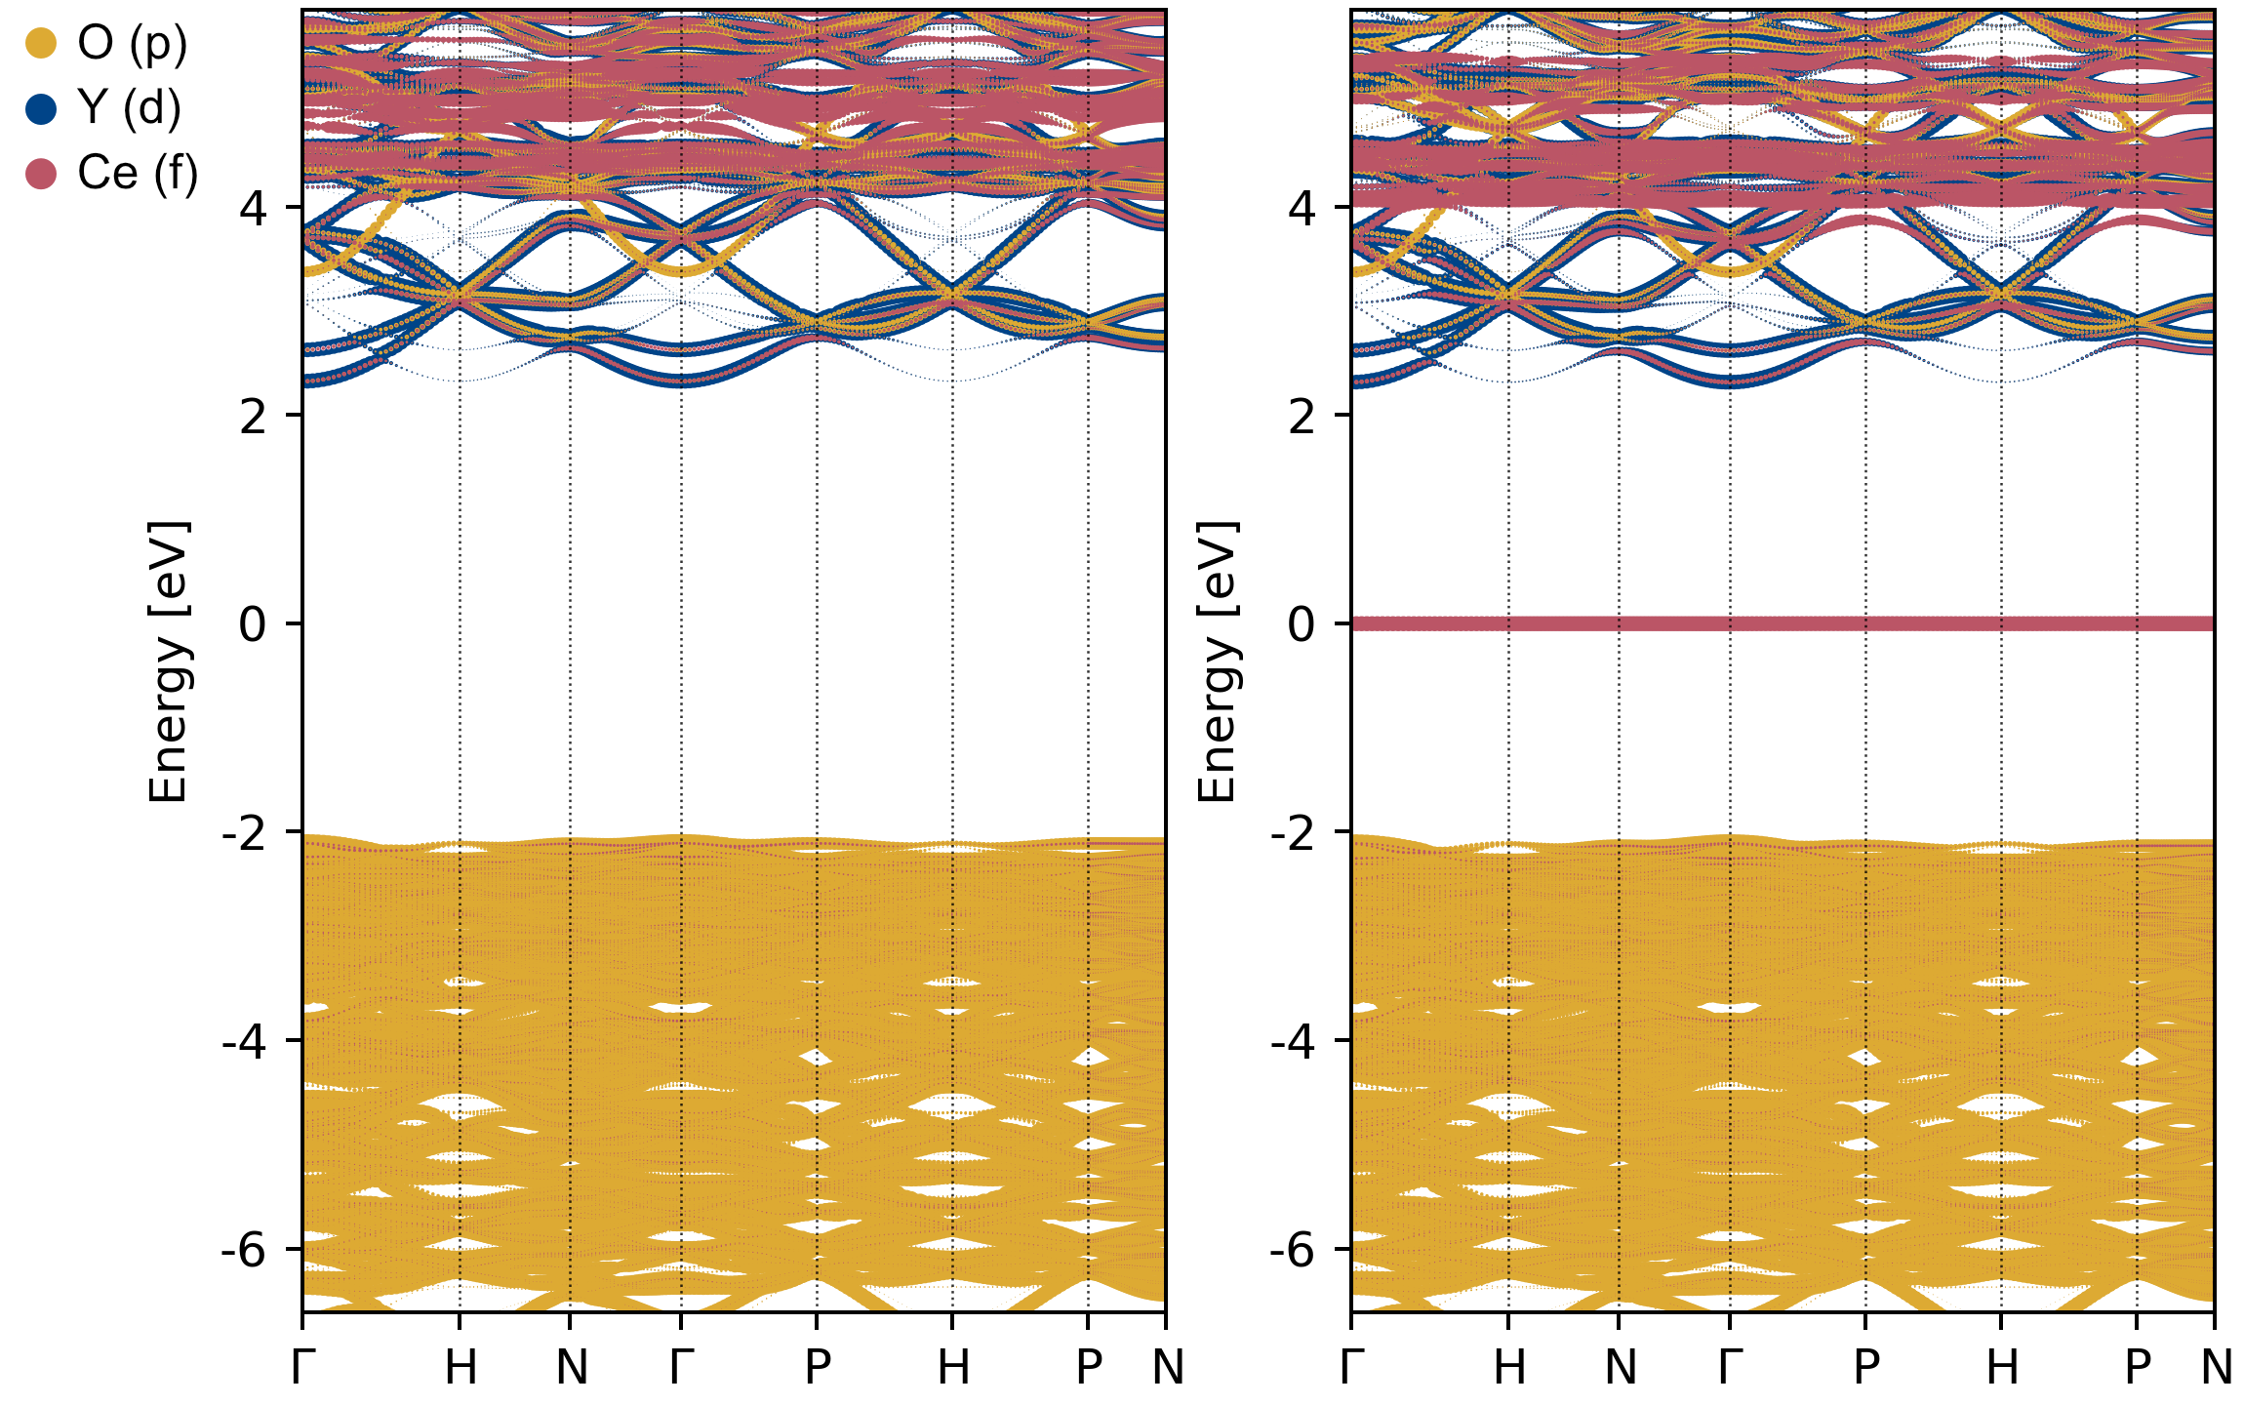
Effect of doping on YAG band structure
Spin up
Spin down
YAG
YAG:Ce (U=5)

Slide 33
Effect of doping on YAG band structure
Spin up
Spin down
Conduction band
Ln 5d (empty)
E
Ln 4f (filled)
Valence band
YAG:Ce (U=5)

Slide 34
Density functional theory calculations
Material | # of atoms | Plane-wave energy cut-off (eV) | k-point mesh
YAG | 80 | 700 | 2 × 2 × 2
YAG supercell | 160 | 700 | 1 × 1 × 1
YAG:Ce | 160 | 700 | 1 × 1 × 1
General calculation information:
PBEsol
Projector augmented wave (PAW) pseudopotentials
Structure relaxation
Electronic convergence criterion: 10⁻⁷ eV
Ionic convergence criterion: norm of forces < 1 meV Å⁻¹
DFT+U
Dudarev (U_{eff}=U-J)

Slide 35
Tuning U in cerium-doped yttrium aluminium garnet (YAG)
One way to get a value of U is to tune it to an experimental parameter.
We chose the valence band maximum to the Ce 4f gap.
YAG conduction band
Ce 5d (empty)
E
 | Approx. energy gaps (eV)
YAG band gap (Slack et al.) | 6.5
YAG band gap (Bok et al.) | 7.8
Ce 4f→CBM gap | 3.7
VBM→Ce 4f gap (Slack et al.) | 2.7
VBM→Ce 4f gap (Bok et al.) | 3.9
Ce 4f (filled)
YAG valence band

Slide 36
Tuning U in cerium-doped yttrium aluminium garnet (YAG)
One way to get a value of U is to tune it to an experimental parameter.
We chose the valence band maximum to the Ce 4f gap.
YAG conduction band
Ce 5d (empty)
E
 | Approx. energy gaps (eV)
YAG band gap (Slack et al.) | 6.5
YAG band gap (Bok et al.) | 7.8
Ce 4f→CBM gap | 3.7
VBM→Ce 4f gap (Slack et al.) | 2.7
VBM→Ce 4f gap (Bok et al.) | 3.9
Ce 4f (filled)
YAG valence band

Slide 37
Tuning U in cerium-doped yttrium aluminium garnet (YAG)
One way to get a value of U is to tune it to an experimental parameter.
We chose the valence band maximum to the Ce 4f gap.
YAG conduction band
Ce 5d (empty)
E
 | Approx. energy gaps (eV)
YAG band gap (Slack et al.) | 6.5
YAG band gap (Bok et al.) | 7.8
Ce 4f→CBM gap | 3.7
VBM→Ce 4f gap (Slack et al.) | 2.7
VBM→Ce 4f gap (Bok et al.) | 3.9
Ce 4f (filled)
YAG valence band

Slide 38
Tuning U in cerium-doped yttrium aluminium garnet (YAG)
One way to get a value of U is to tune it to an experimental parameter.
We chose the valence band maximum to the Ce 4f gap.
YAG conduction band
Ce 5d (empty)
E
 | Approx. energy gaps (eV)
YAG band gap (Slack et al.) | 6.5
YAG band gap (Bok et al.) | 7.8
Ce 4f→CBM gap | 3.7
VBM→Ce 4f gap (Slack et al.) | 2.7
VBM→Ce 4f gap (Bok et al.) | 3.9
Ce 4f (filled)
YAG valence band

Slide 39
Tuning U in cerium-doped yttrium aluminium garnet (YAG)
One way to get a value of U is to tune it to an experimental parameter.
We chose the valence band maximum to the Ce 4f gap.
YAG conduction band
Ce 5d (empty)
E
 | Approx. energy gaps (eV)
YAG band gap (Slack et al.) | 6.5
YAG band gap (Bok et al.) | 7.8
Ce 4f→CBM gap | 3.7
VBM→Ce 4f gap (Slack et al.) | 2.7
VBM→Ce 4f gap (Bok et al.) | 3.9
Ce 4f (filled)
YAG valence band

Slide 40
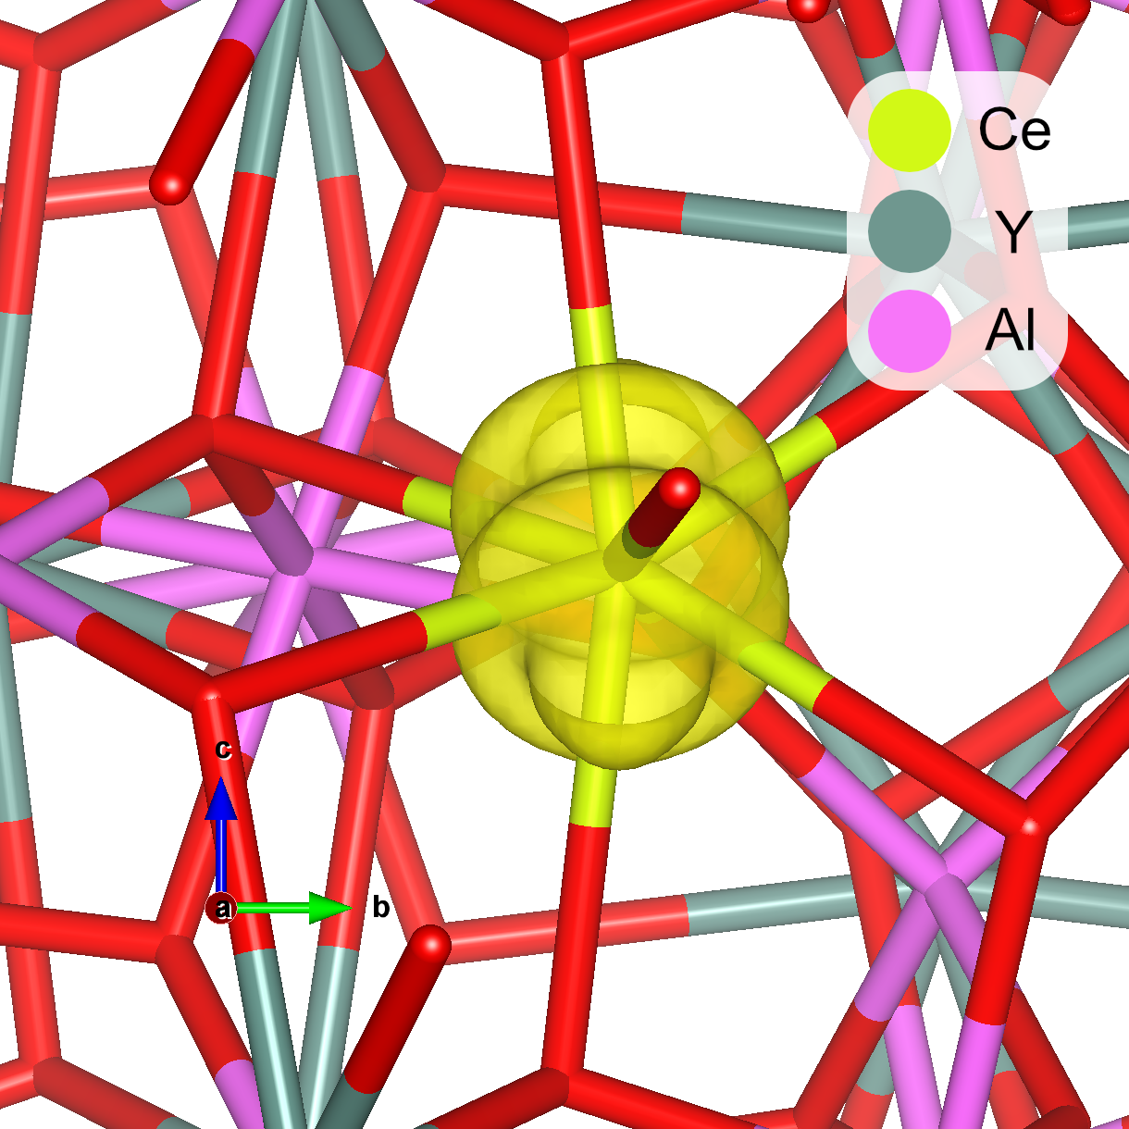
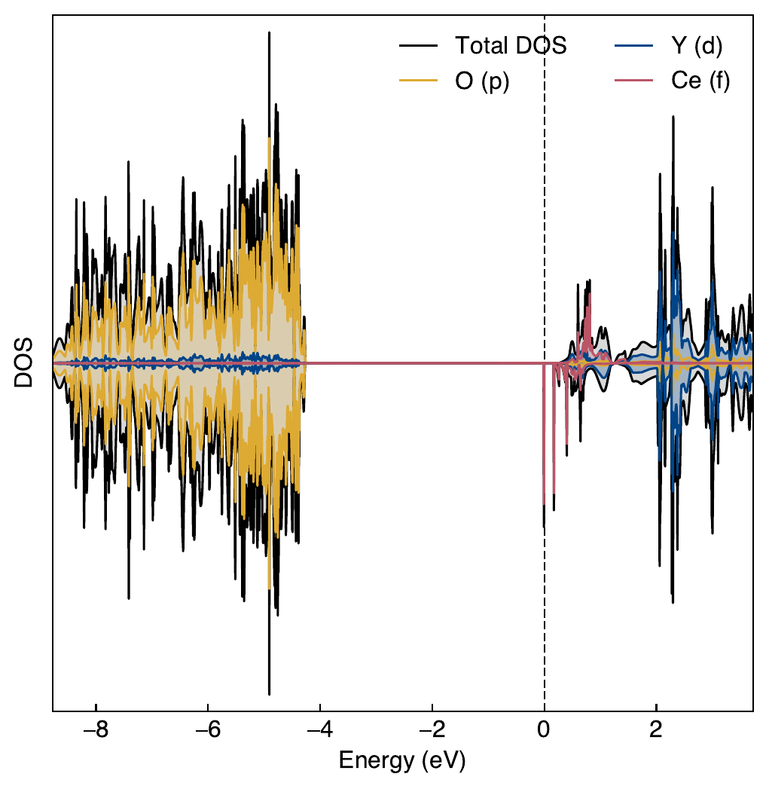
Tuning U in cerium-doped yttrium aluminium garnet (YAG)
U=0
Filled
Unfilled
4.3 eV
Even U=0 shows localization of the Ce 4f state

Slide 41
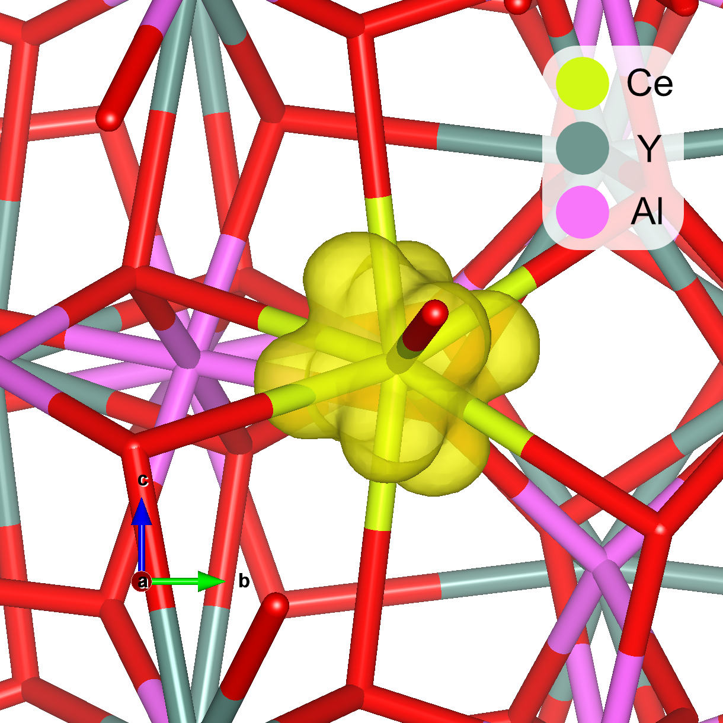
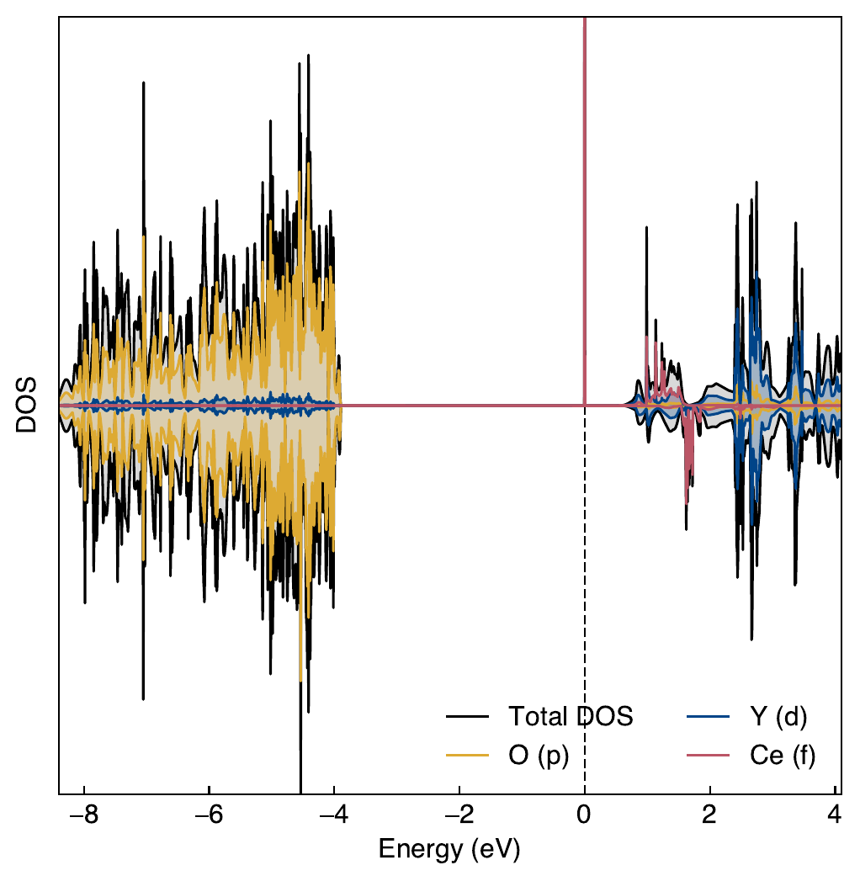
Tuning U in cerium-doped yttrium aluminium garnet (YAG)
U=1
3.9 eV
~3.9 eV is the Bok et al. value

Slide 42
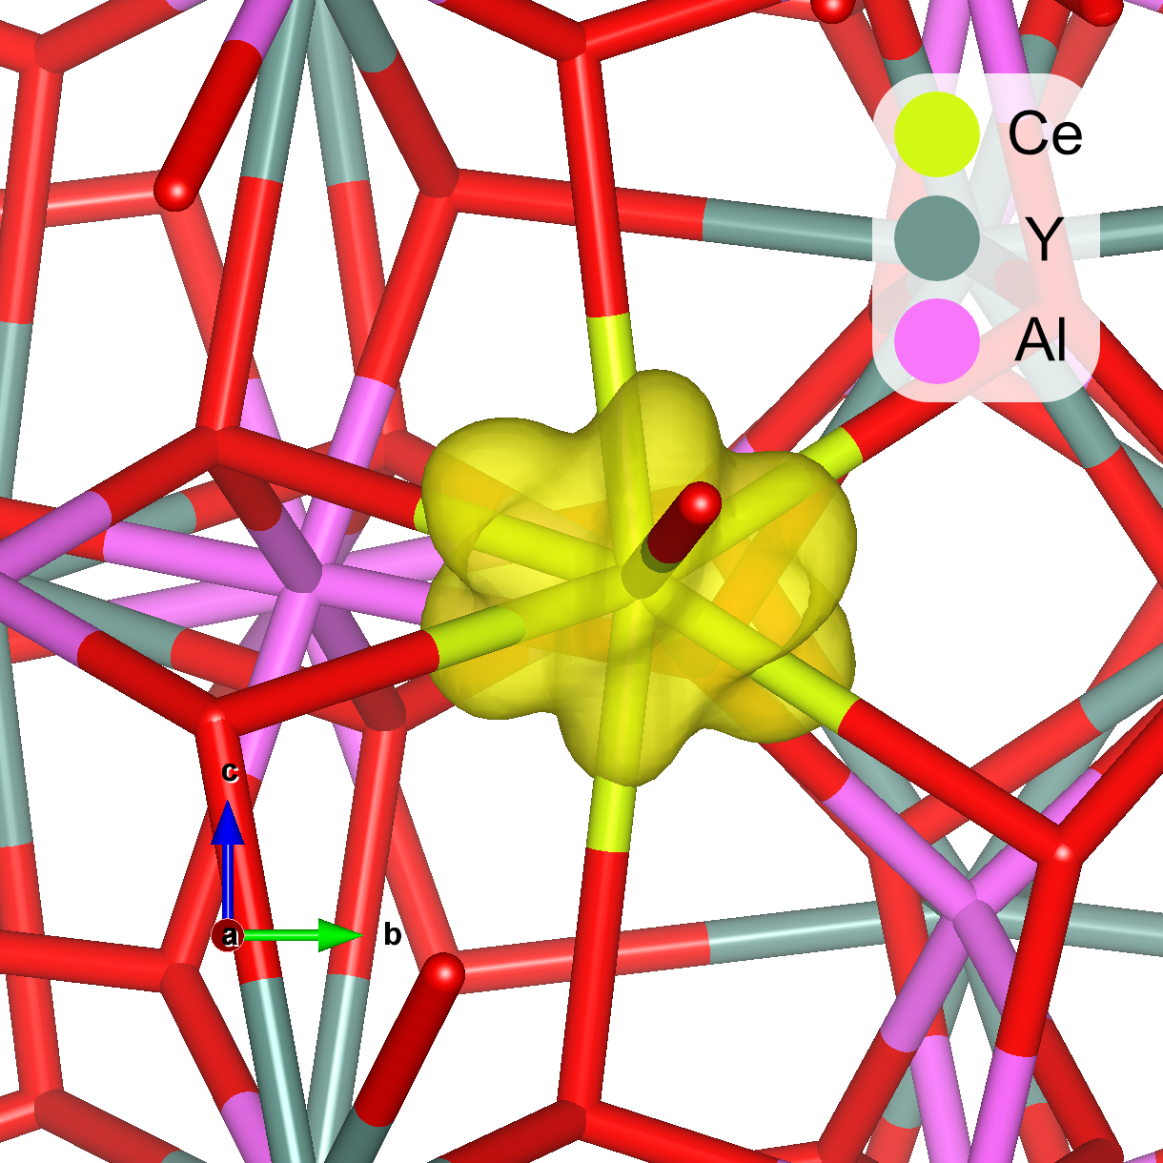
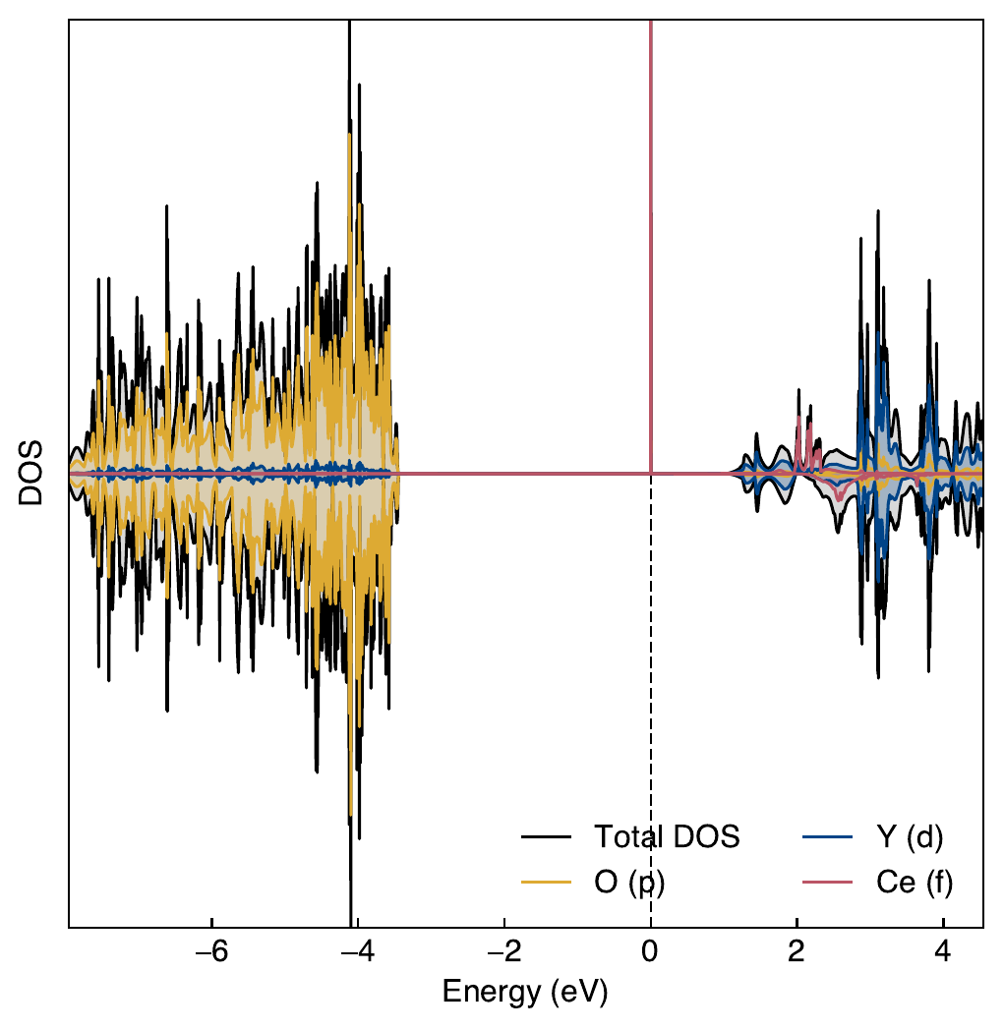
Tuning U in cerium-doped yttrium aluminium garnet (YAG)
U=2
3.5 eV

Slide 43

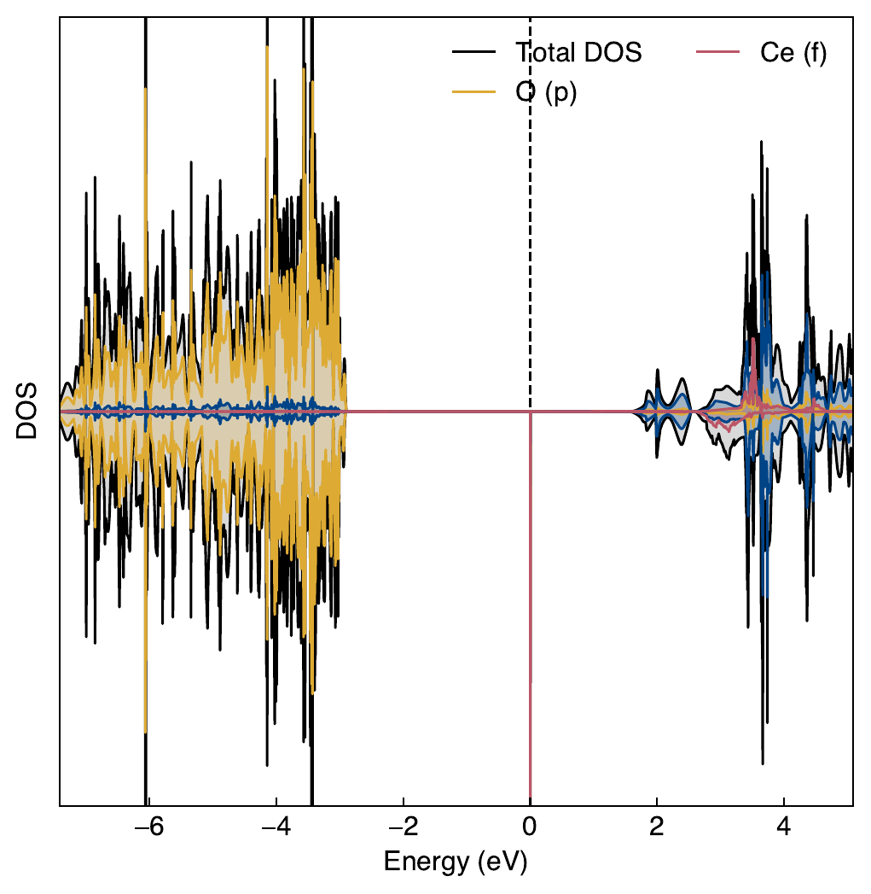
Tuning U in cerium-doped yttrium aluminium garnet (YAG)
U=3
2.9 eV

Slide 44
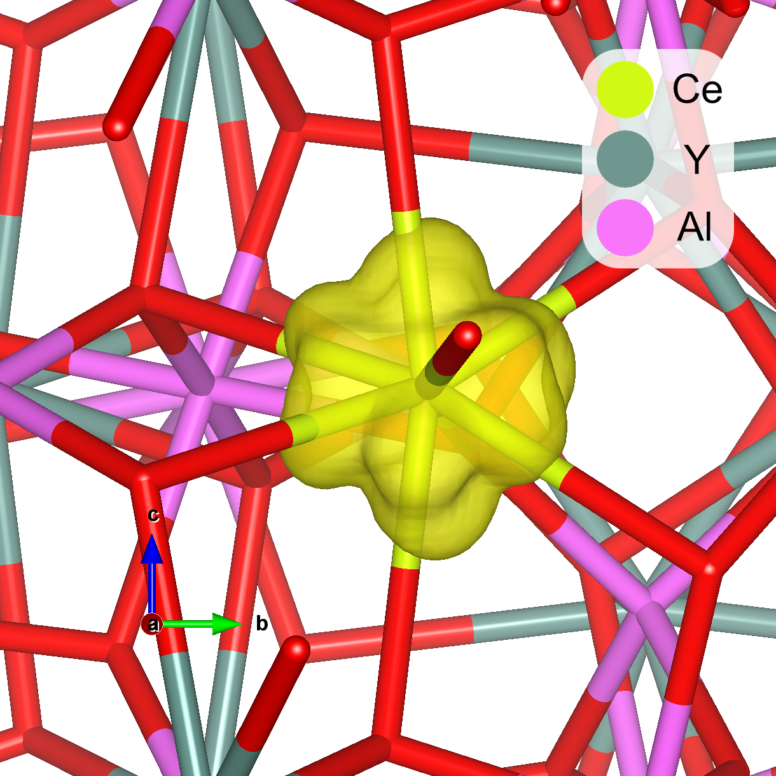
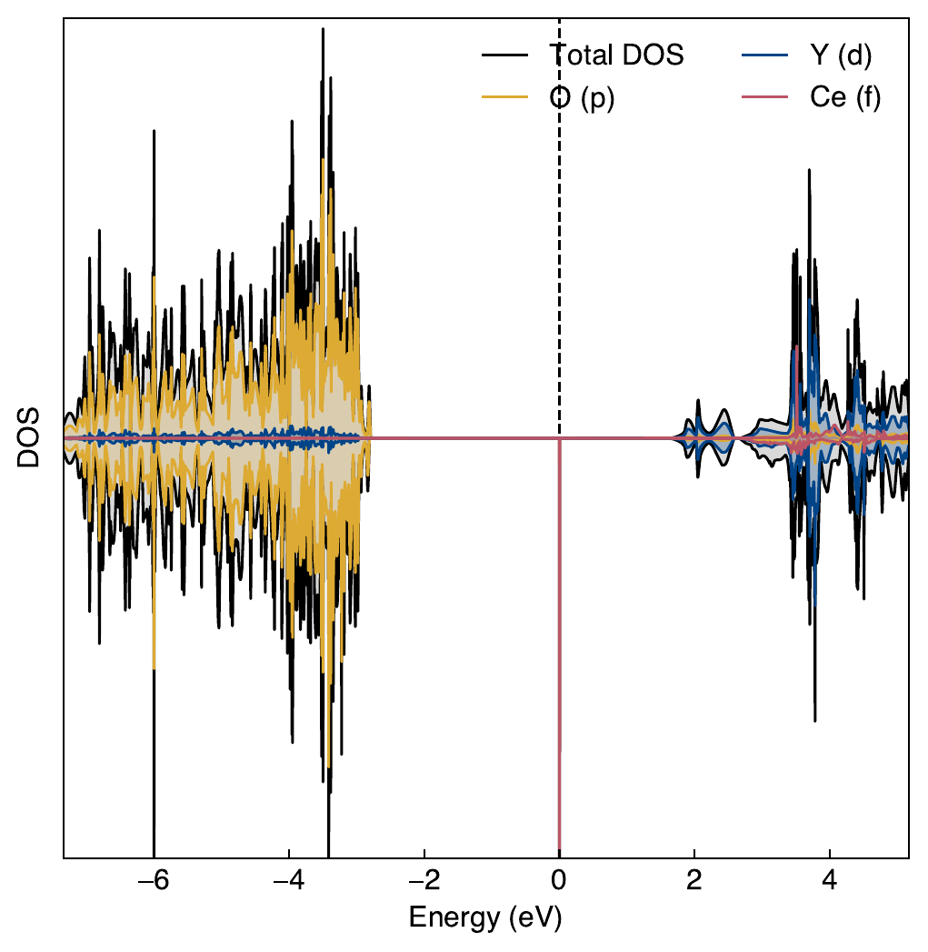
Tuning U in cerium-doped yttrium aluminium garnet (YAG)
U=4
2.8 eV
~2.7 eV is the Slack et al. value

Slide 45

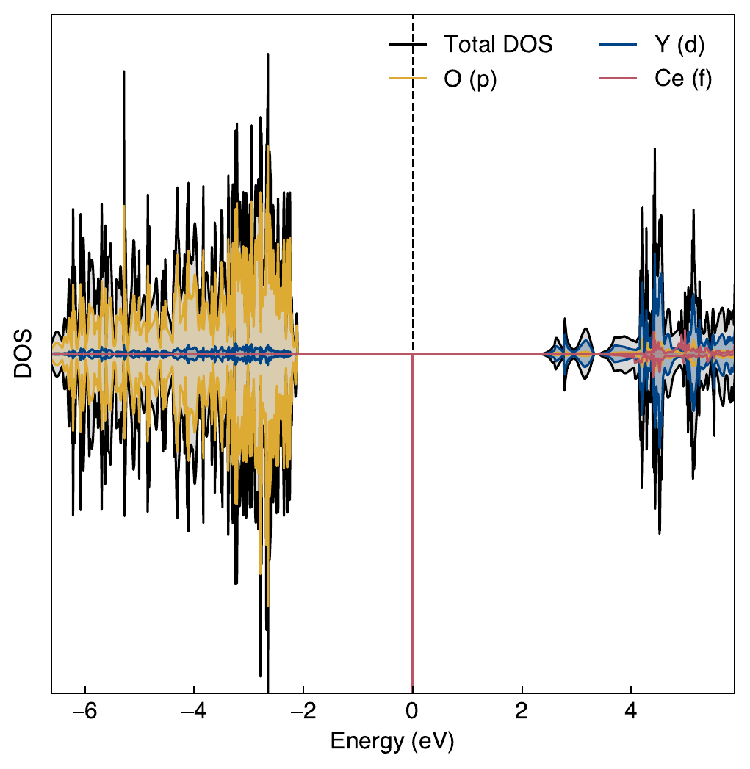
Tuning U in cerium-doped yttrium aluminium garnet (YAG)
U=5
2.1 eV

Slide 46
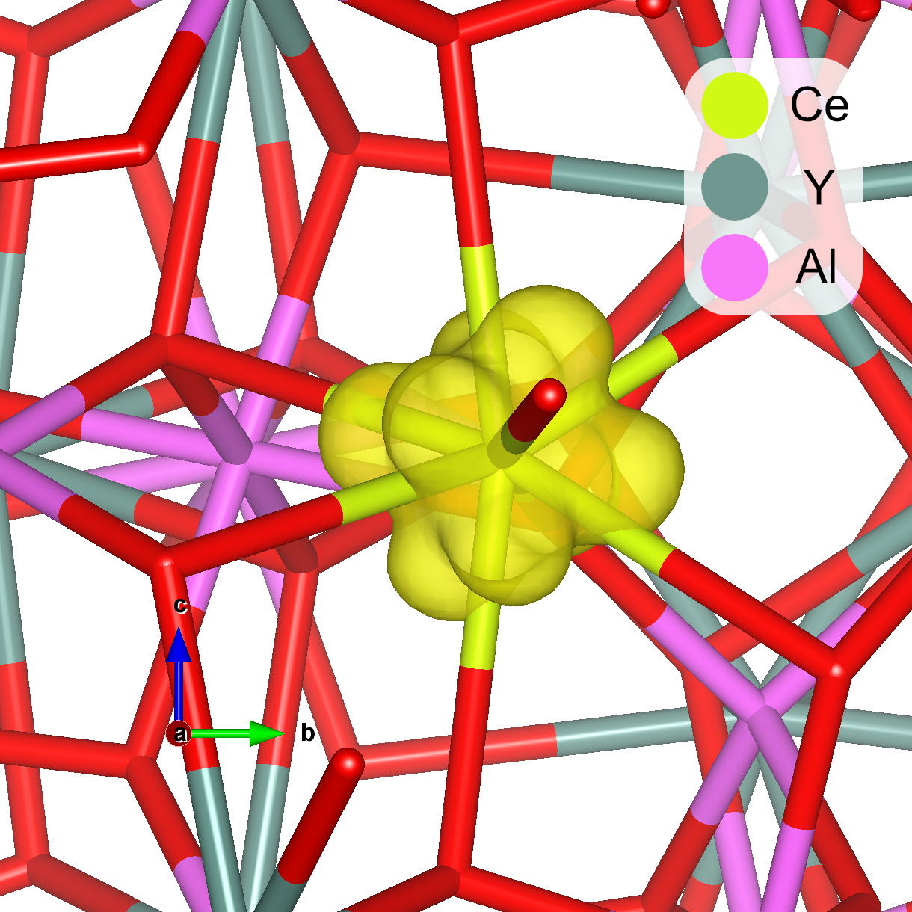
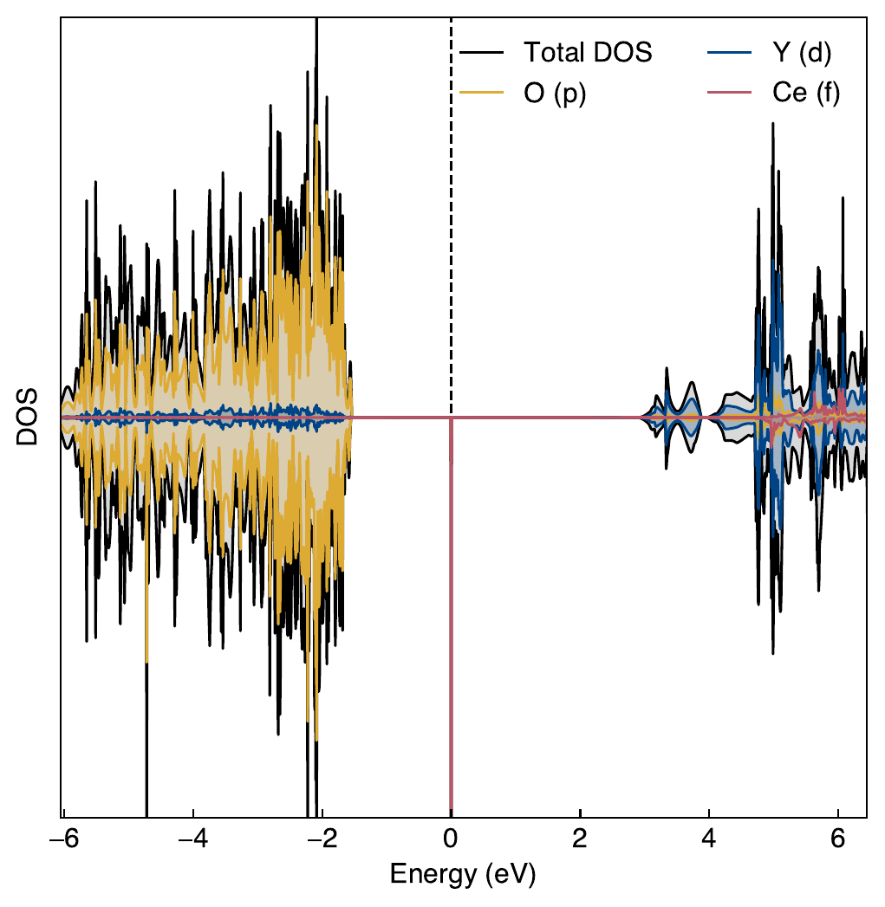
Tuning U in cerium-doped yttrium aluminium garnet (YAG)
U=6
1.6 eV

Slide 47

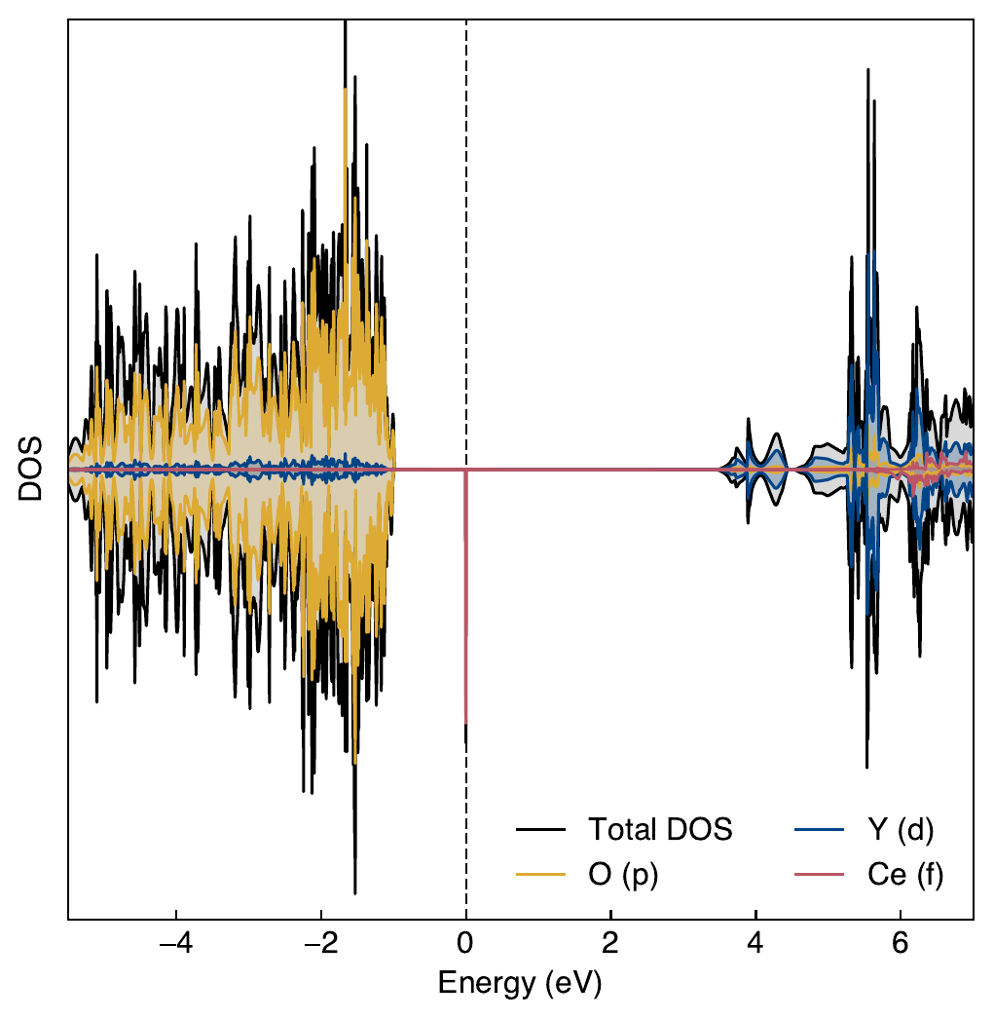
Tuning U in cerium-doped yttrium aluminium garnet (YAG)
U=7
1.0 eV

Slide 48
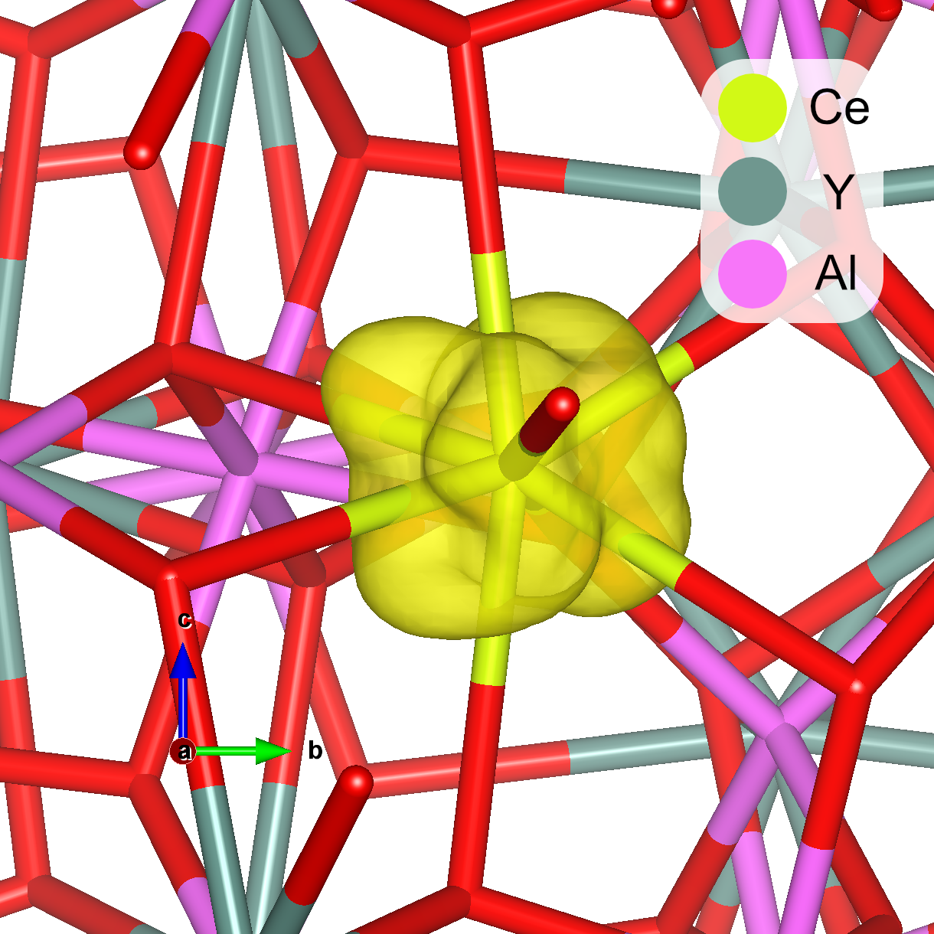
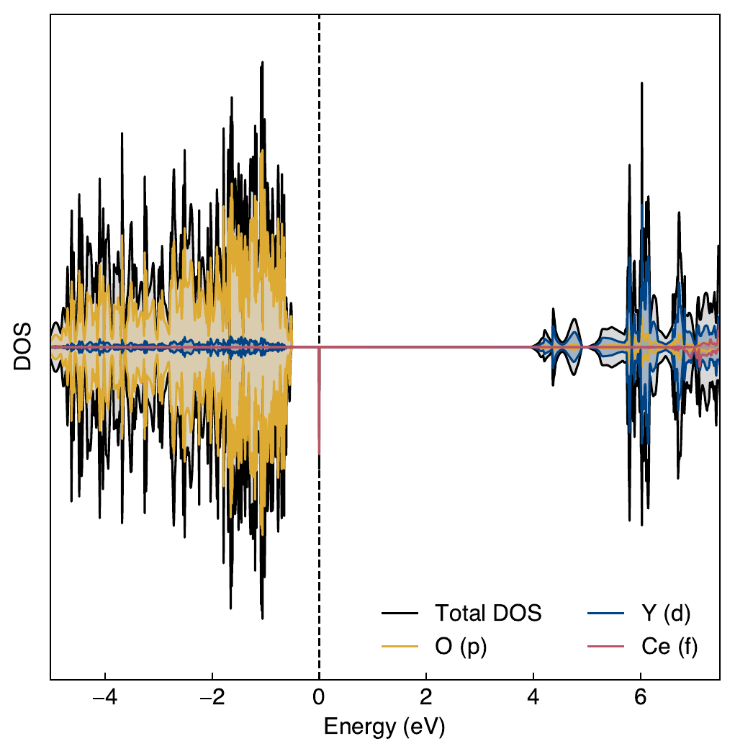
Tuning U in cerium-doped yttrium aluminium garnet (YAG)
U=8
0.5 eV

Slide 49
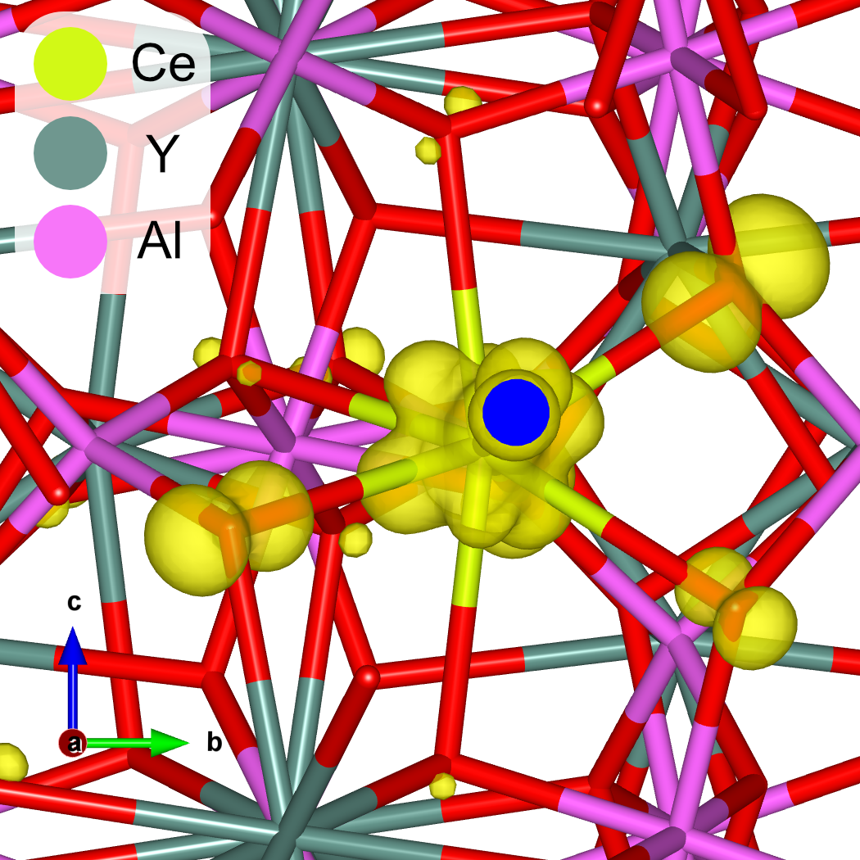
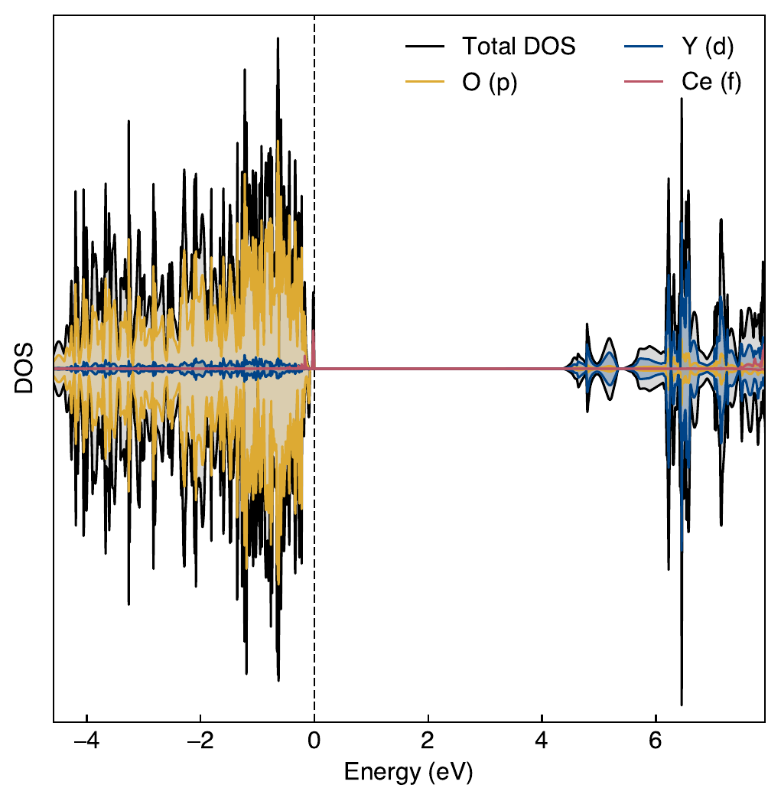
Tuning U in cerium-doped yttrium aluminium garnet (YAG)
U=9 (not converged)
0.1 eV
U=9 Ce 4f band shows delocalisation

Slide 50
Tuning U in cerium-doped yttrium aluminium garnet (YAG)
Summary:
U=1 gives a VBM→Ce 4f gap of 3.9 eV – this is the Bok et al. value.
U=4 gives a VBM→Ce 4f gap of 2.8 eV – close to the Slack et al. value of ~2.7 eV.
Since the Slack et al. value is more commonly used, future DFT+U calculations primarily use U=4.

Slide 51
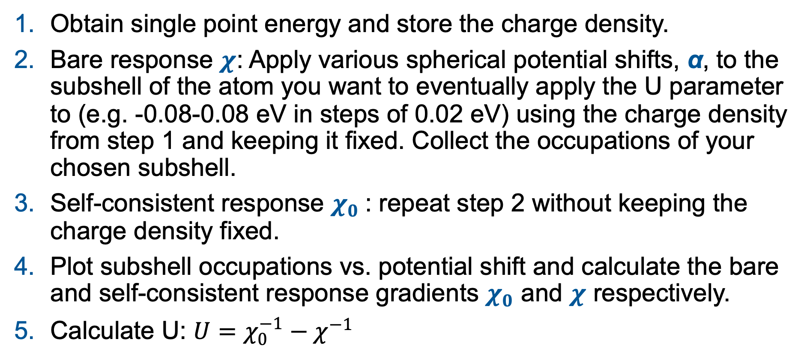
Obtaining U ab initio – the linear response method – Cococcioni et al.
General method:
Obtain single point energy and store the charge density.
Bare response $χ$: Apply various spherical potential shifts, α, to the subshell of the atom you want to eventually apply the U parameter to (e.g. -0.08-0.08 eV in steps of 0.02 eV) using the charge density from step 1 and keeping it fixed. Collect the occupations of your chosen subshell.
Self-consistent response $χ_{0}$: repeat step 2 without keeping the charge density fixed.
Plot subshell occupations vs. potential shift and calculate the bare and self-consistent response gradients $χ_{0}$ and $χ$ respectively.
Calculate U: $U=χ_{0}^{−1}−χ^{−1}$

Slide 52
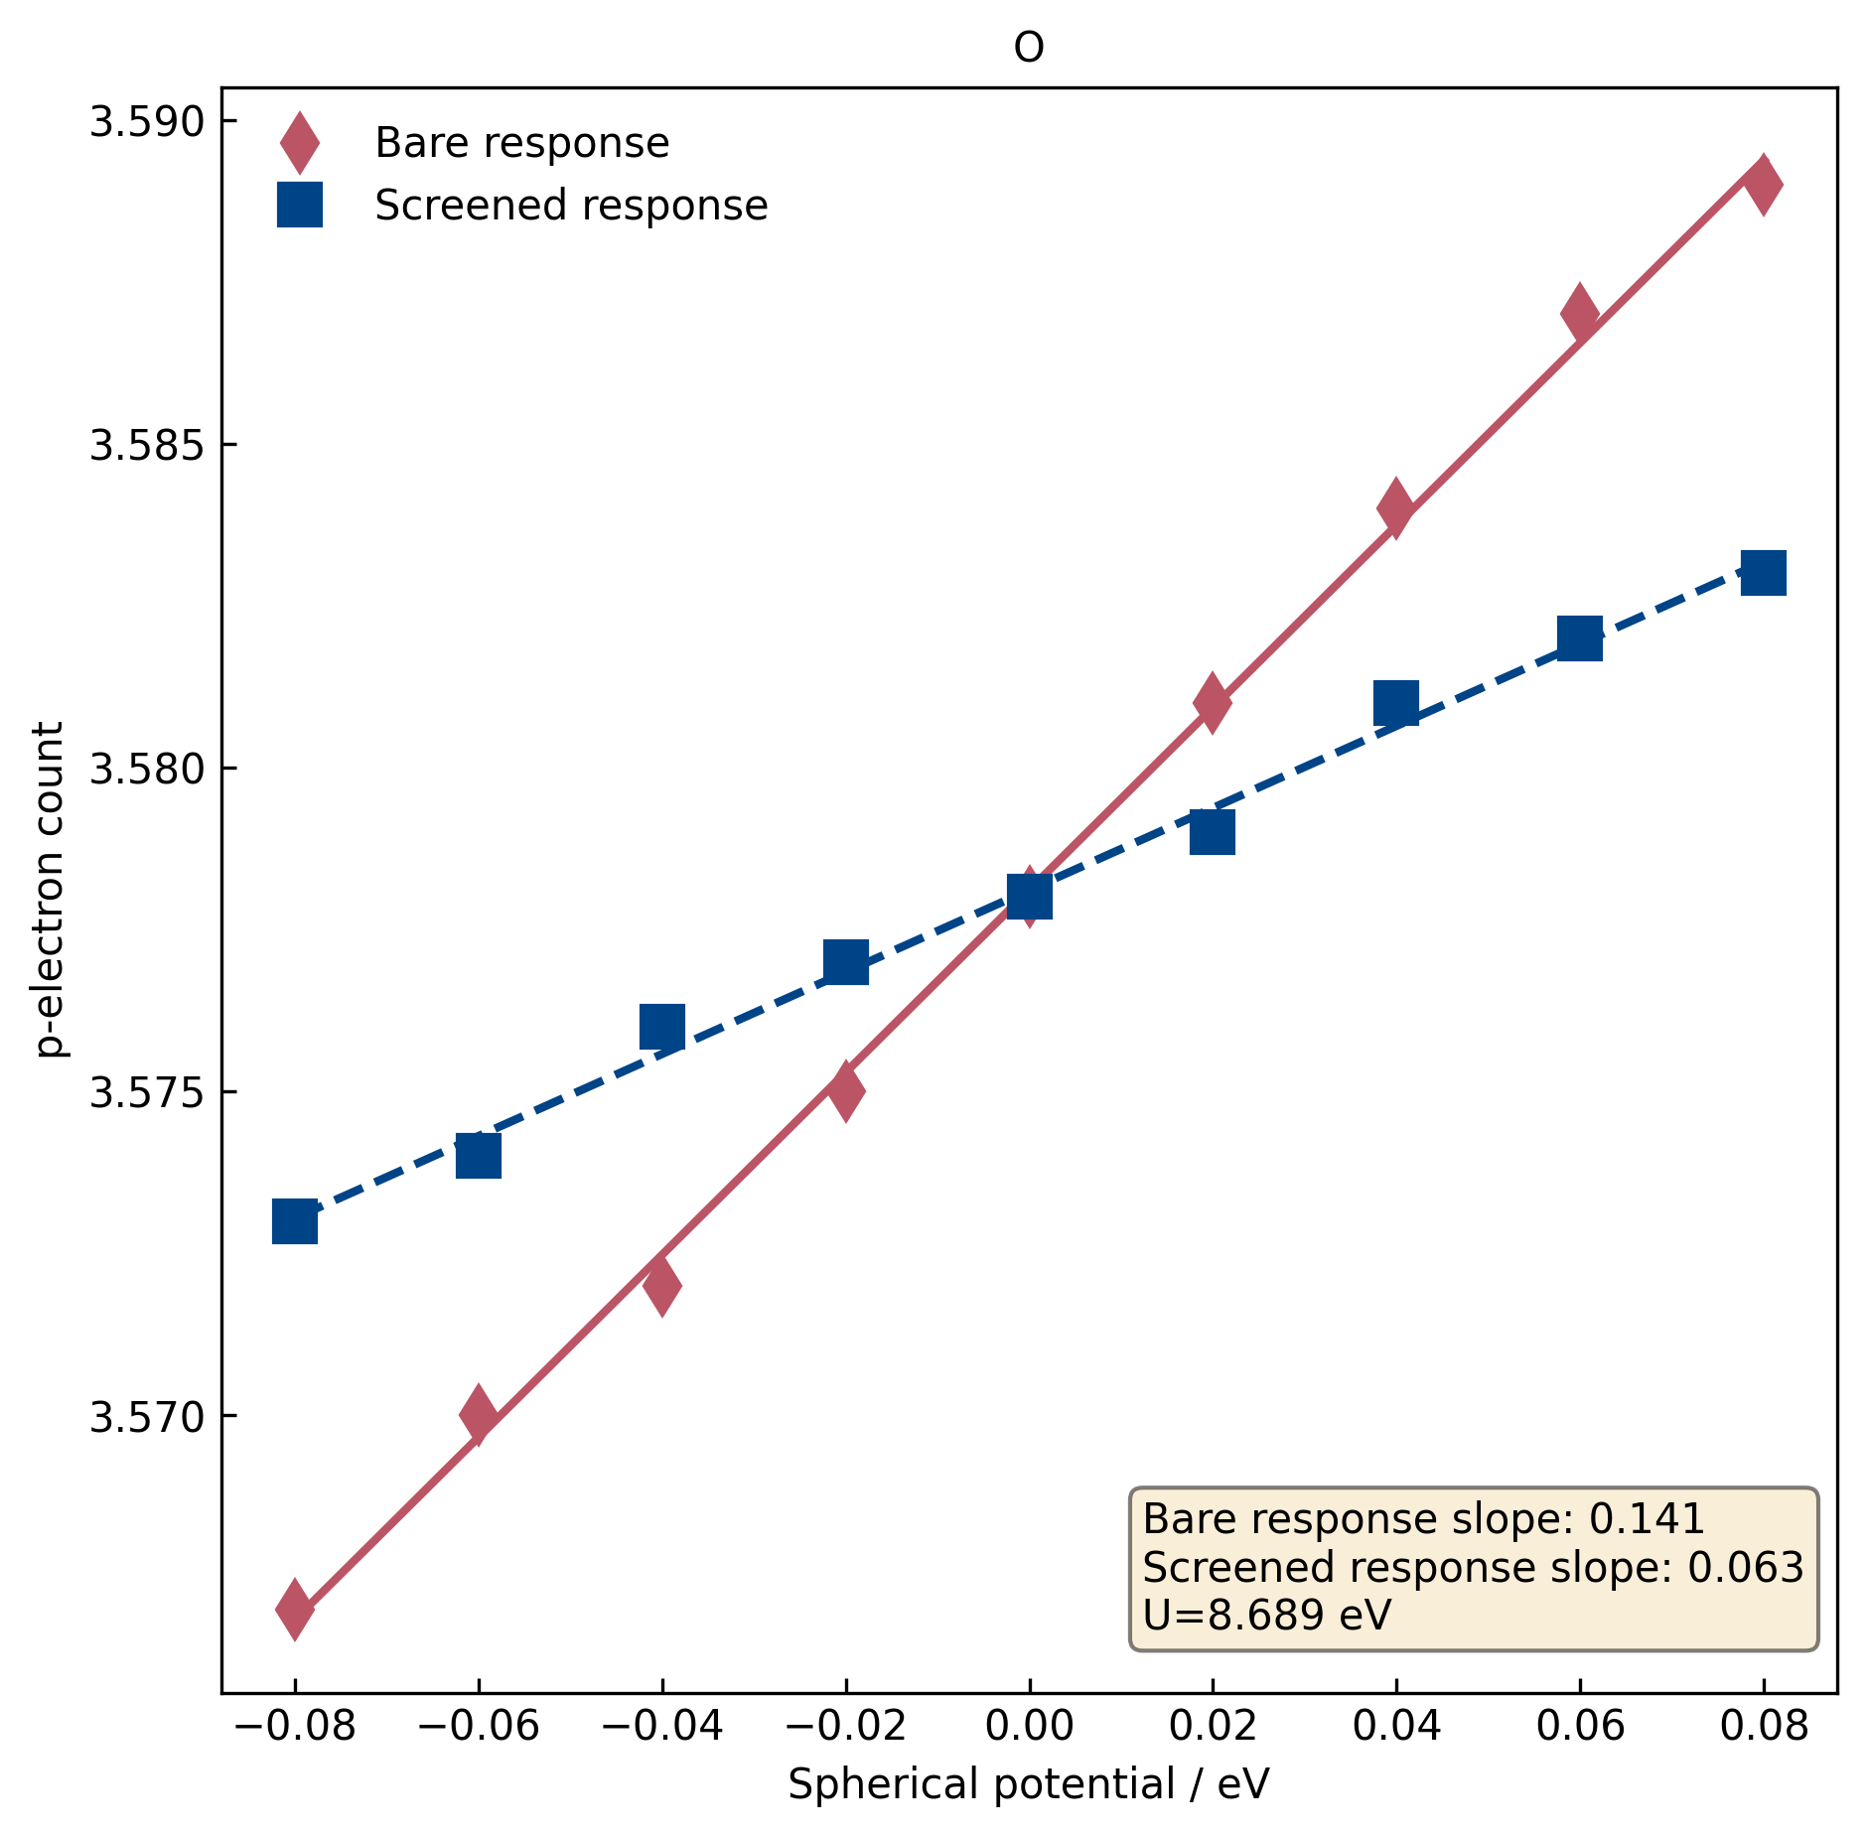
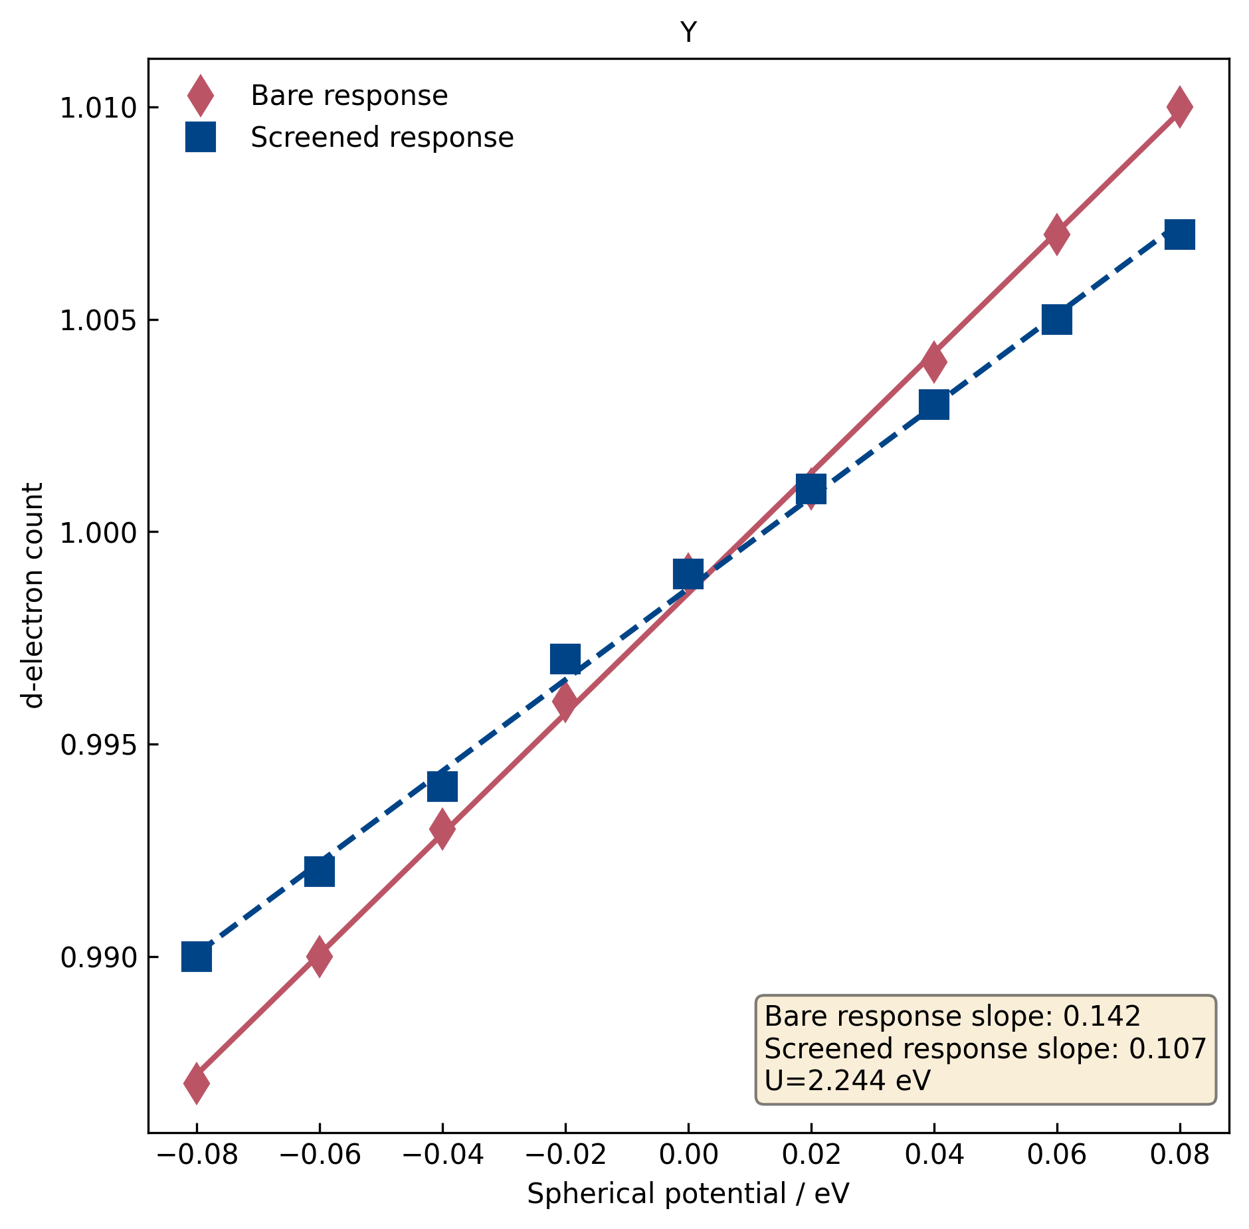
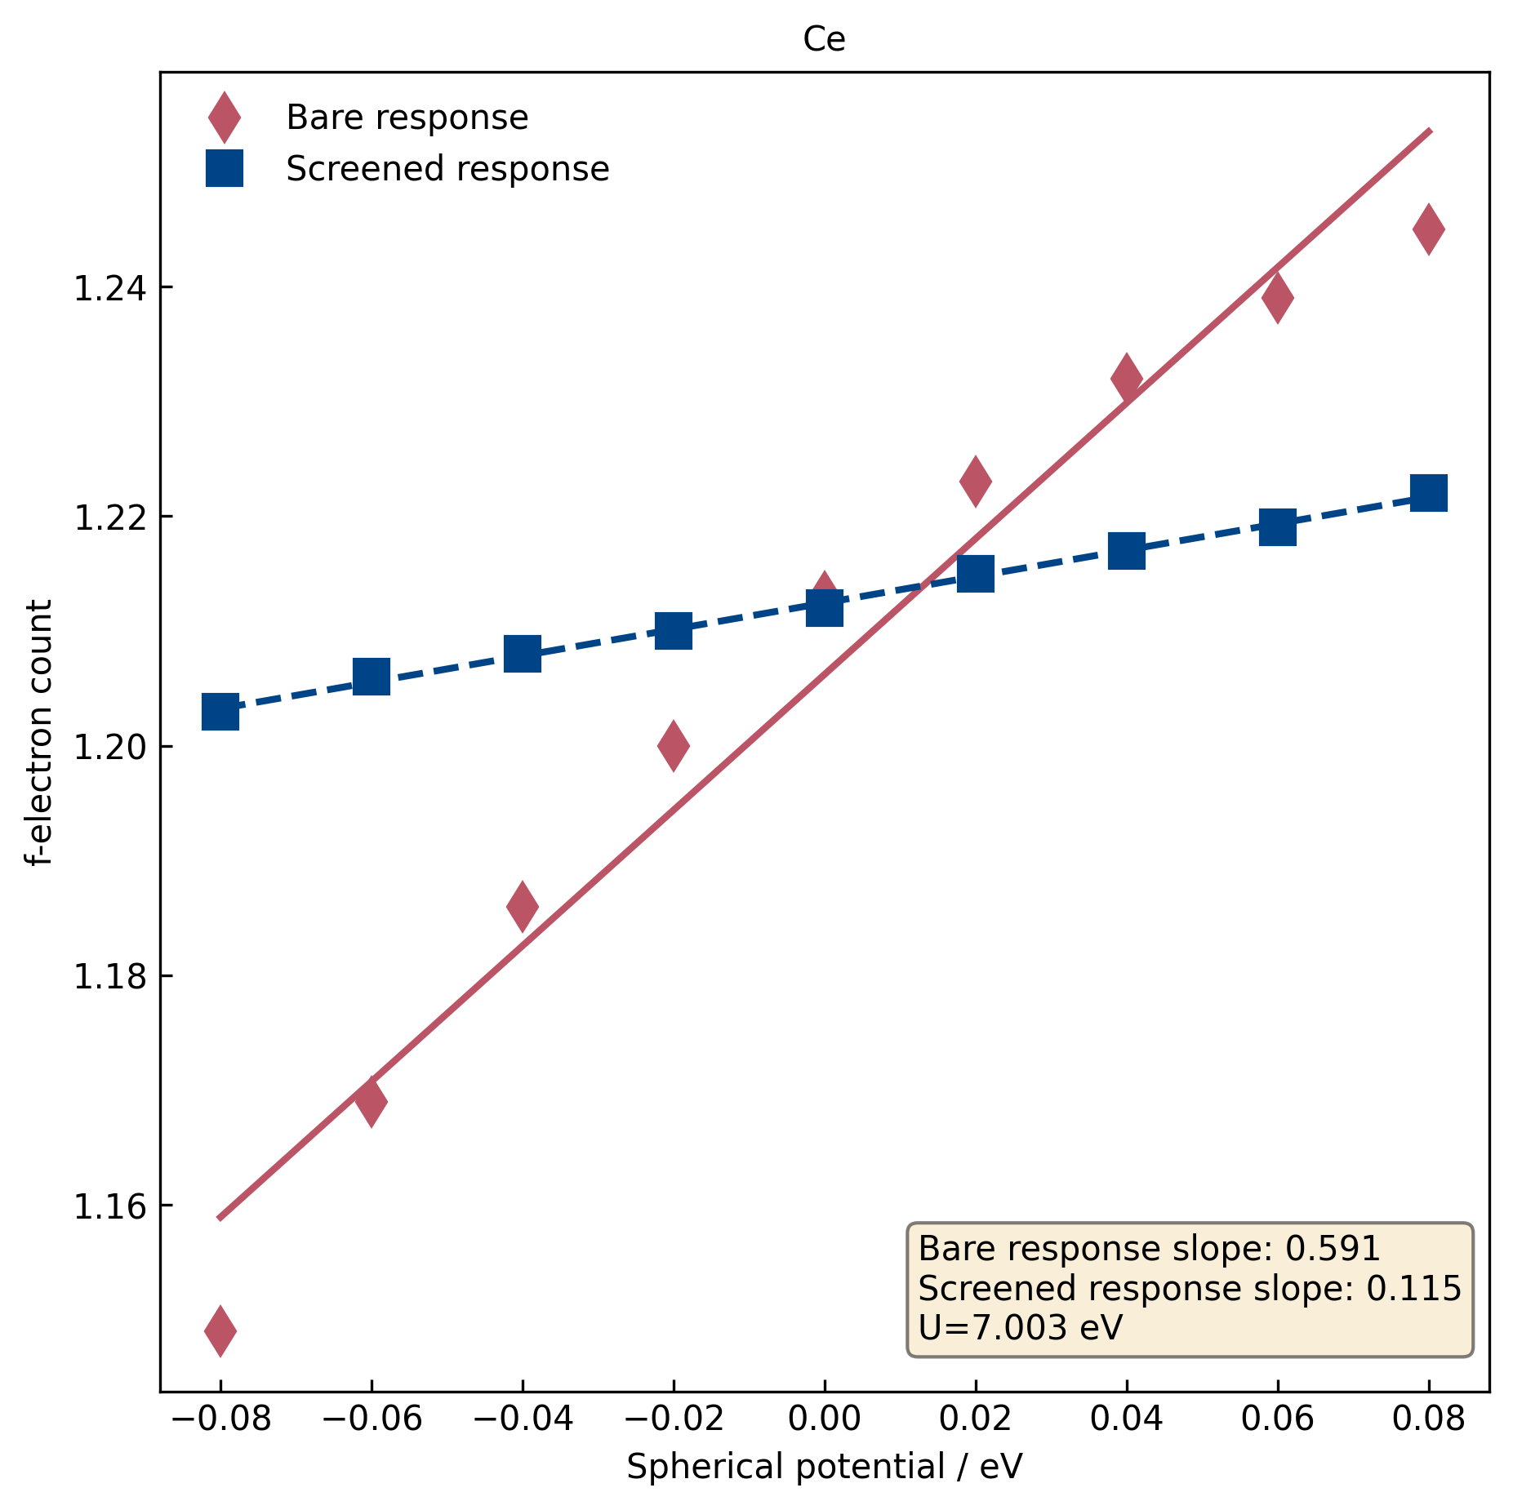
Obtaining U ab initio – the linear response method – Cococcioni et al.
O (2p)
Y (4d)
Ce (4f)

Slide 53
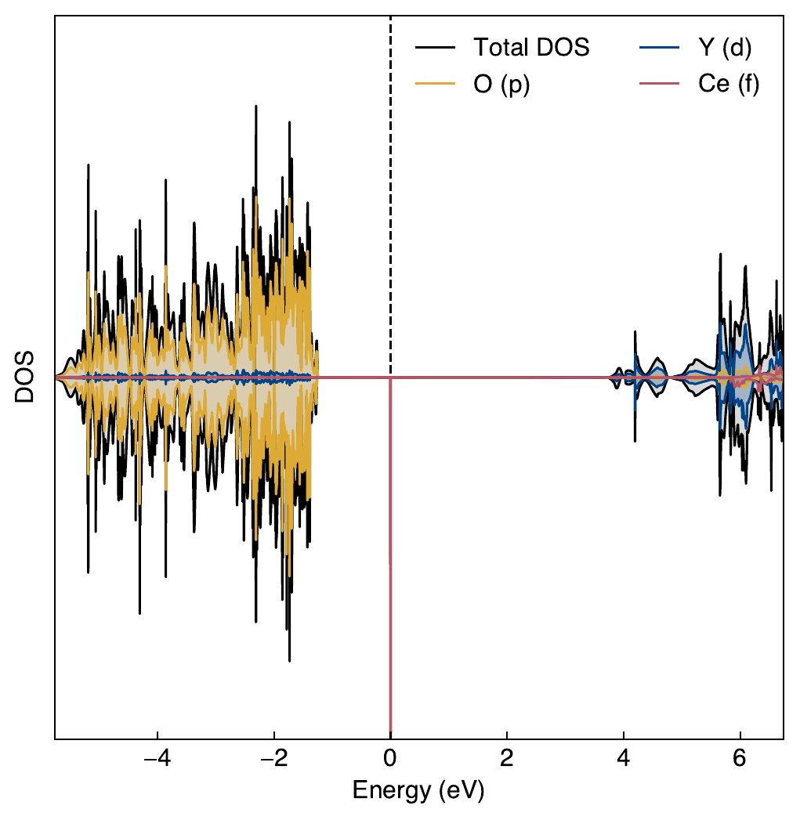
Obtaining U ab initio – the linear response method – Cococcioni et al.
Applying U values from linear response to O 2p, Y 4d and Ce 4f
Applying U=4 to Ce 4f only
4.4 eV
5.0 eV
2.8 eV
1.3 eV

Slide 54
Liechtenstein and Dudarev implementations
Liechtenstein (rotationally invariant) formulation:
Introduced in 1995 as an improvement to the original (rotationally variant/Anisimov) formulation.
Explicitly models the U and J parameters.
Seldon sees use.
Dudarev (simplified) formulation:
‘Simplified’ relative to the Liechtenstein formulation.
Introduced in 1998.
Models the U and J parameters as U_{eff}.
Preferred DFT+U formulation.

Slide 55
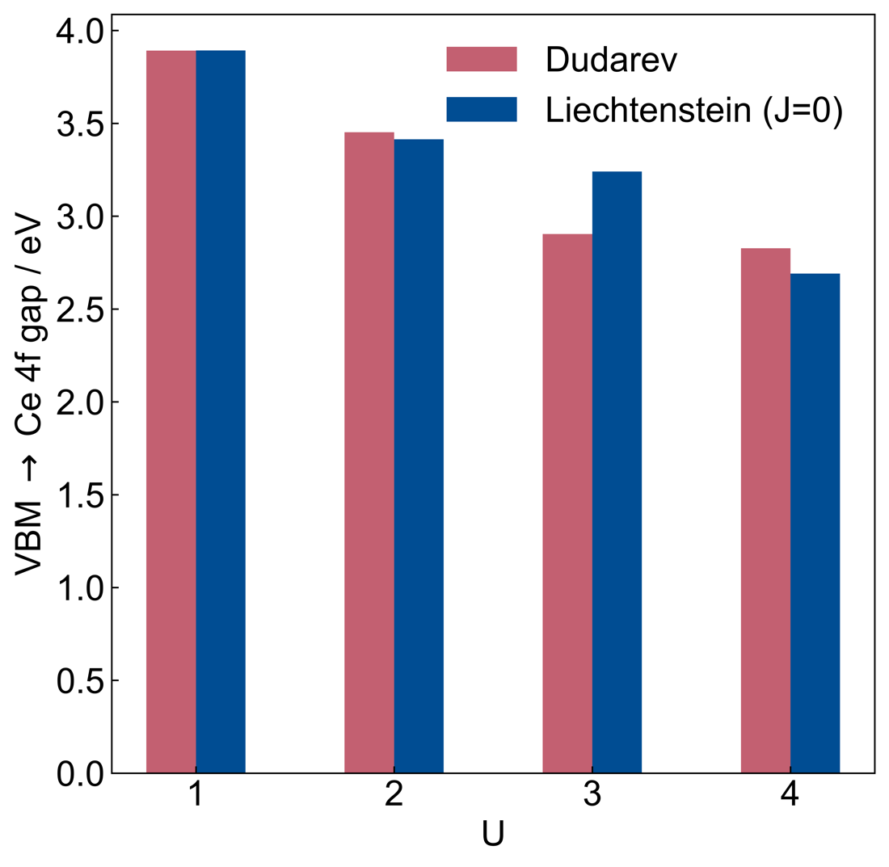
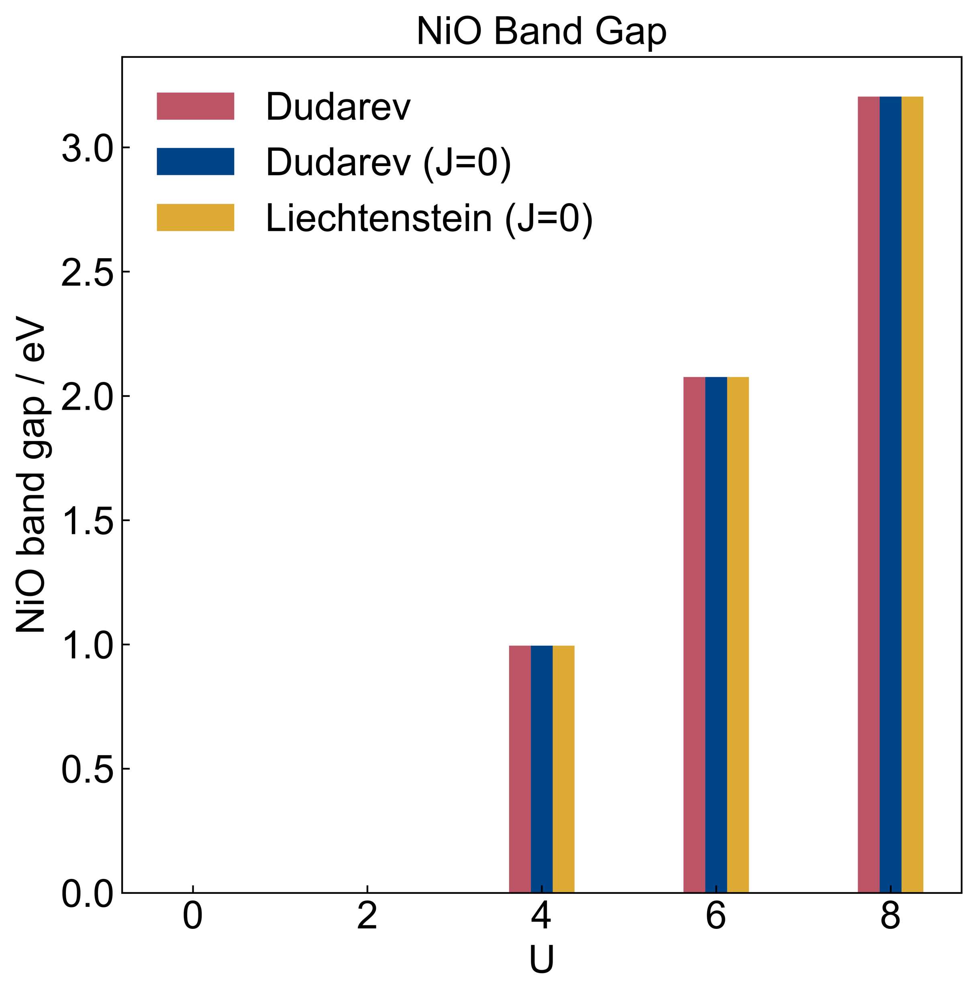
Dudarev vs. Liechtenstein formulations and metastability issues
YAG:Ce (Ce 4f-subshell)
NiO (Ni 3d-subshell)

Slide 56
Dudarev vs. Liechtenstein formulations and metastability issues
YAG:Ce (Ce 4f-subshell)
NiO (Ni 3d-subshell)
The differences for YAG:Ce are due to convergence to different states for a given U value.

Slide 57
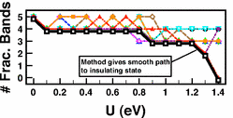
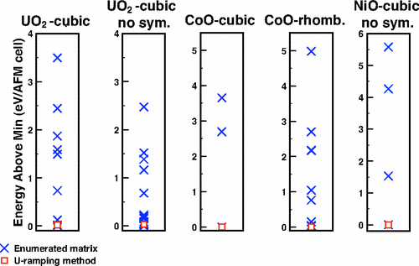
U-ramping – Meredig et al.
U-ramping method: Increase U from 0 to a target value in small steps (e.g. 0.1).
U-ramping helps address DFT’s derivative discontinuity problem

Slide 58
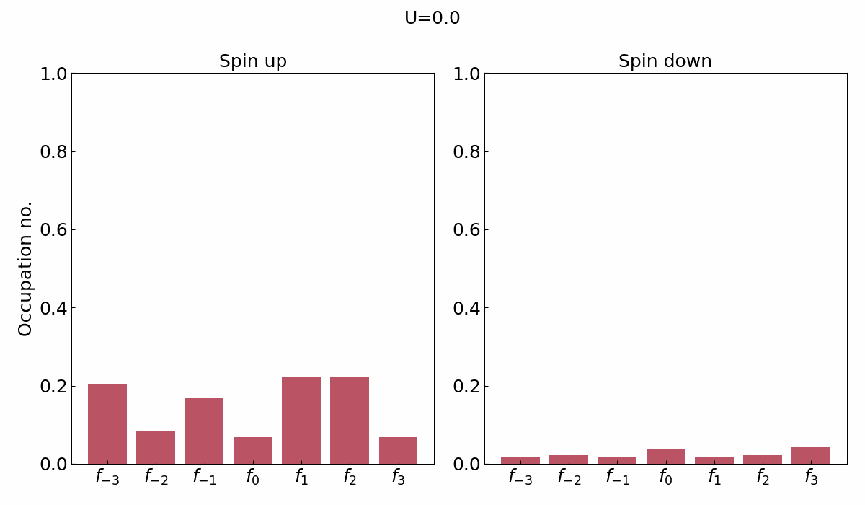
Applying U-ramping to Ce 4f in YAG:Ce
U-ramping method: Increase U from 0 to a target value in small steps (e.g. 0.1).
Getting closer to integral occupation.

Slide 59

Occupation matrix control – Jomard/Amadon/Dorado et al.
Perform a structure relaxation with occupation matrix control.
Initial occupation matrix
$$\left[\begin{matrix}1 & 0 & 0 & 0 & 0 & 0 & 0 \\ 0 & 0 & 0 & 0 & 0 & 0 & 0 \\ 0 & 0 & 0 & 0 & 0 & 0 & 0 \\ 0 & 0 & 0 & 0 & 0 & 0 & 0 \\ 0 & 0 & 0 & 0 & 0 & 0 & 0 \\ 0 & 0 & 0 & 0 & 0 & 0 & 0 \\ 0 & 0 & 0 & 0 & 0 & 0 & 0\end{matrix}\right]$$
Integral occupation of a lead diagonal element corresponds to localisation on a given orbital.
Localisation on f₋₃

Slide 60

Occupation matrix control – Jomard/Amadon/Dorado et al.
Perform a structure relaxation with occupation matrix control.
Continue from the resultant wavefunction of the previous step and perform another structure relaxation without imposing occupation matrix control.
Initial occupation matrix
$$\left[\begin{matrix}1 & 0 & 0 & 0 & 0 & 0 & 0 \\ 0 & 0 & 0 & 0 & 0 & 0 & 0 \\ 0 & 0 & 0 & 0 & 0 & 0 & 0 \\ 0 & 0 & 0 & 0 & 0 & 0 & 0 \\ 0 & 0 & 0 & 0 & 0 & 0 & 0 \\ 0 & 0 & 0 & 0 & 0 & 0 & 0 \\ 0 & 0 & 0 & 0 & 0 & 0 & 0\end{matrix}\right]$$
Integral occupation of a lead diagonal element corresponds to localisation on a given orbital.
Localisation on f₋₃

Slide 61


Occupation matrix control – Jomard/Amadon/Dorado et al.
Resultant occupation nos.
Initial occupation matrix
$$\left[\begin{matrix}1 & 0 & 0 & 0 & 0 & 0 & 0 \\ 0 & 0 & 0 & 0 & 0 & 0 & 0 \\ 0 & 0 & 0 & 0 & 0 & 0 & 0 \\ 0 & 0 & 0 & 0 & 0 & 0 & 0 \\ 0 & 0 & 0 & 0 & 0 & 0 & 0 \\ 0 & 0 & 0 & 0 & 0 & 0 & 0 \\ 0 & 0 & 0 & 0 & 0 & 0 & 0\end{matrix}\right]$$
Localisation on f₋₃

Slide 62


Occupation matrix control – Jomard/Amadon/Dorado et al.
Resultant occupation nos.
Initial occupation matrix
$$\left[\begin{matrix}0 & 0 & 0 & 0 & 0 & 0 & 0 \\ 0 & 1 & 0 & 0 & 0 & 0 & 0 \\ 0 & 0 & 0 & 0 & 0 & 0 & 0 \\ 0 & 0 & 0 & 0 & 0 & 0 & 0 \\ 0 & 0 & 0 & 0 & 0 & 0 & 0 \\ 0 & 0 & 0 & 0 & 0 & 0 & 0 \\ 0 & 0 & 0 & 0 & 0 & 0 & 0\end{matrix}\right]$$
Localisation on f₋₂

Slide 63


Occupation matrix control – Jomard/Amadon/Dorado et al.
Resultant occupation nos.
Initial occupation matrix
$$\left[\begin{matrix}0 & 0 & 0 & 0 & 0 & 0 & 0 \\ 0 & 0 & 0 & 0 & 0 & 0 & 0 \\ 0 & 0 & 1 & 0 & 0 & 0 & 0 \\ 0 & 0 & 0 & 0 & 0 & 0 & 0 \\ 0 & 0 & 0 & 0 & 0 & 0 & 0 \\ 0 & 0 & 0 & 0 & 0 & 0 & 0 \\ 0 & 0 & 0 & 0 & 0 & 0 & 0\end{matrix}\right]$$
Localisation on f₋₁

Slide 64


Occupation matrix control – Jomard/Amadon/Dorado et al.
Resultant occupation nos.
Initial occupation matrix
$$\left[\begin{matrix}0 & 0 & 0 & 0 & 0 & 0 & 0 \\ 0 & 0 & 0 & 0 & 0 & 0 & 0 \\ 0 & 0 & 0 & 0 & 0 & 0 & 0 \\ 0 & 0 & 0 & 1 & 0 & 0 & 0 \\ 0 & 0 & 0 & 0 & 0 & 0 & 0 \\ 0 & 0 & 0 & 0 & 0 & 0 & 0 \\ 0 & 0 & 0 & 0 & 0 & 0 & 0\end{matrix}\right]$$
Localisation on f₀

Slide 65


Occupation matrix control – Jomard/Amadon/Dorado et al.
Resultant occupation nos.
Initial occupation matrix
$$\left[\begin{matrix}0 & 0 & 0 & 0 & 0 & 0 & 0 \\ 0 & 0 & 0 & 0 & 0 & 0 & 0 \\ 0 & 0 & 0 & 0 & 0 & 0 & 0 \\ 0 & 0 & 0 & 0 & 0 & 0 & 0 \\ 0 & 0 & 0 & 0 & 1 & 0 & 0 \\ 0 & 0 & 0 & 0 & 0 & 0 & 0 \\ 0 & 0 & 0 & 0 & 0 & 0 & 0\end{matrix}\right]$$
Localisation on f₁

Slide 66


Occupation matrix control – Jomard/Amadon/Dorado et al.
Resultant occupation nos.
Initial occupation matrix
$$\left[\begin{matrix}0 & 0 & 0 & 0 & 0 & 0 & 0 \\ 0 & 0 & 0 & 0 & 0 & 0 & 0 \\ 0 & 0 & 0 & 0 & 0 & 0 & 0 \\ 0 & 0 & 0 & 0 & 0 & 0 & 0 \\ 0 & 0 & 0 & 0 & 0 & 0 & 0 \\ 0 & 0 & 0 & 0 & 0 & 1 & 0 \\ 0 & 0 & 0 & 0 & 0 & 0 & 0\end{matrix}\right]$$
Localisation on f₂

Slide 67


Occupation matrix control – Jomard/Amadon/Dorado et al.
Resultant occupation nos.
Initial occupation matrix
$$\left[\begin{matrix}0 & 0 & 0 & 0 & 0 & 0 & 0 \\ 0 & 0 & 0 & 0 & 0 & 0 & 0 \\ 0 & 0 & 0 & 0 & 0 & 0 & 0 \\ 0 & 0 & 0 & 0 & 0 & 0 & 0 \\ 0 & 0 & 0 & 0 & 0 & 0 & 0 \\ 0 & 0 & 0 & 0 & 0 & 0 & 0 \\ 0 & 0 & 0 & 0 & 0 & 0 & 1\end{matrix}\right]$$
Localisation on f₃

Slide 68


U-ramping vs. occupation matrix control
Occupation matrix control does not always find the ground state

Slide 69

Quasi-annealing – Geng et al.
Simulated annealing is used in molecular dynamics to attempt to find the ground state configuration.
Quasi-annealing applies the principles of simulated annealing to an electronic system.
Notes:
In a classical system, the metastable states difficulty can be tackled satisfactorily with annealing procedure. Namely, to remove the thermal kinetic energy of a system gradually and slowly so that all low-lying states have been visited before picking out the ground solution. Similar concept can be applied to electronic system. The basic idea is to shake or heat the electronic system with a spurious energy noise to help it overcome the energy barriers. We call this method the quasiannealing QA procedure.

Slide 70
Quasi-annealing – Geng et al.
Very vague overview:
Perform structure relaxations with increasingly stricter electronic convergence criteria and ionic step lengths.
After each structure relaxation, ‘restore’ the structure to the one used prior to performing a structure relaxation.
Once all structure relaxations with the stricter parameters is completed, get the energy per atom of the final structure, then perturb the final structure and use it as the ‘basis of restoration’ for the next set of structure relaxations.
Repeat steps 1-3 until the difference in final structure energies is less than a given tolerance value, e.g. 0.1 meV/atom.

Slide 71

Workflow diagram of my implementation of QA

Slide 72

Quasi-annealing – Geng et al.
Ideally used after another metastability fixer, such as U-ramping.
Problem: an ionic convergence criterion of 0.01/0.02 eV/Å were used in the quasi-annealing papers. Our calculations stalled when we tried to use such a criterion. We then swapped to an energy-based criterion and had to tweak the amount of distortion for perturbation.
Attempt no. | QA convergence criterion (meV/atom) | Distortion range (Å) | ΔE between UR & QA (eV)
1 | 0.1 | 10⁻⁵-10⁻³ | -0.0001
2 | 0.01 | 10⁻⁵-10⁻² | +0.152
3 | 0.01 | 10⁻⁵-10⁻² | +0.153
a.k.a. U-ramping
This method is not reliable
Notes:
In a classical system, the metastable states difficulty can be tackled satisfactorily with annealing procedure. Namely, to remove the thermal kinetic energy of a system gradually and slowly so that all low-lying states have been visited before picking out the ground solution. Similar concept can be applied to electronic system. The basic idea is to shake or heat the electronic system with a spurious energy noise to help it overcome the energy barriers. We call this method the quasiannealing QA procedure.

Slide 73


F-occupation smearing and U-ramping (FOUR) – Rabone and Krack
Set equal occupation nos. for all orbitals throughout a U-ramping run with a step of 0.1.
Continue from the resultant wavefunctions from step 1 and perform a U-ramping run with a step of 0.05 without using occupation matrix control.
Step 1
Step 2

Slide 74
Summary
Methods and techniques covered so far
Dudarev and Liechtenstein (DFT+U methods)
Linear response method (determining U)
Occupation matrix control (metastability)
U-ramping (metastability)
Quasi-annealing (metastability)
F-occupation and U-ramping (metastability)

Slide 75
Future work
Use Ilya’s quantum embedding program (if it is ready) to get a more accurate band structure for YAG:Ce.
DFT+U+V
DFT+U+J
SCF linear response method
Applying U to multiple subshells on a given atom
Explore ways to bring down unfilled 5d-orbitals

Slide 76
Thank you for your attention. Any questions?

